Slide 1
UNIT NO – 2 percentage
SUBJECT :QALR
Dr.N.Manjula
ASSISTANT PROFESSOR OF MATHEMATICS SCIENCE & HUMANITIES SNIST

Slide 2
PROFIT AND LOSS
Important Facts:
Cost Price: The price at which an article is purchased is called its cost price, abbreviated as C.P.
Selling Price: The price at which an article is sold is called its selling price, abbreviated as S.P.
Profit or Gain: If S.P is greater than C.P, the seller is said to have a profit or gain.
Loss: If S.P is less than C.P, the seller is said to have incurred a loss.

Slide 3
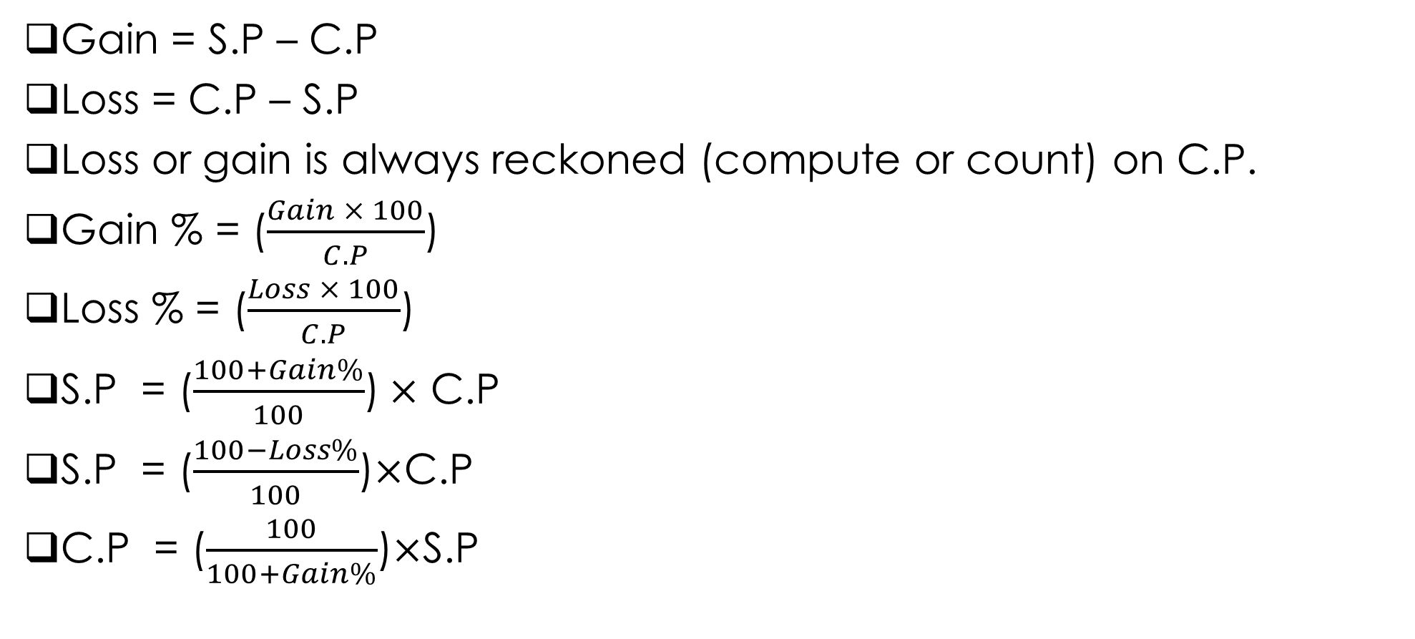
FORMULAE
Gain = S.P – C.P
Loss = C.P – S.P
Loss or gain is always reckoned (compute or count) on C.P.
Gain % = ($\frac{Gain × 100}{C.P}$)
Loss % = ($\frac{Loss × 100}{C.P}$)
S.P = ($\frac{100+Gain\%}{100}$)$×$ C.P
S.P = ($\frac{100−Loss\%}{100}$)$×$C.P
C.P = ($\frac{100}{100+Gain\%}$)$×$S.P

Slide 4
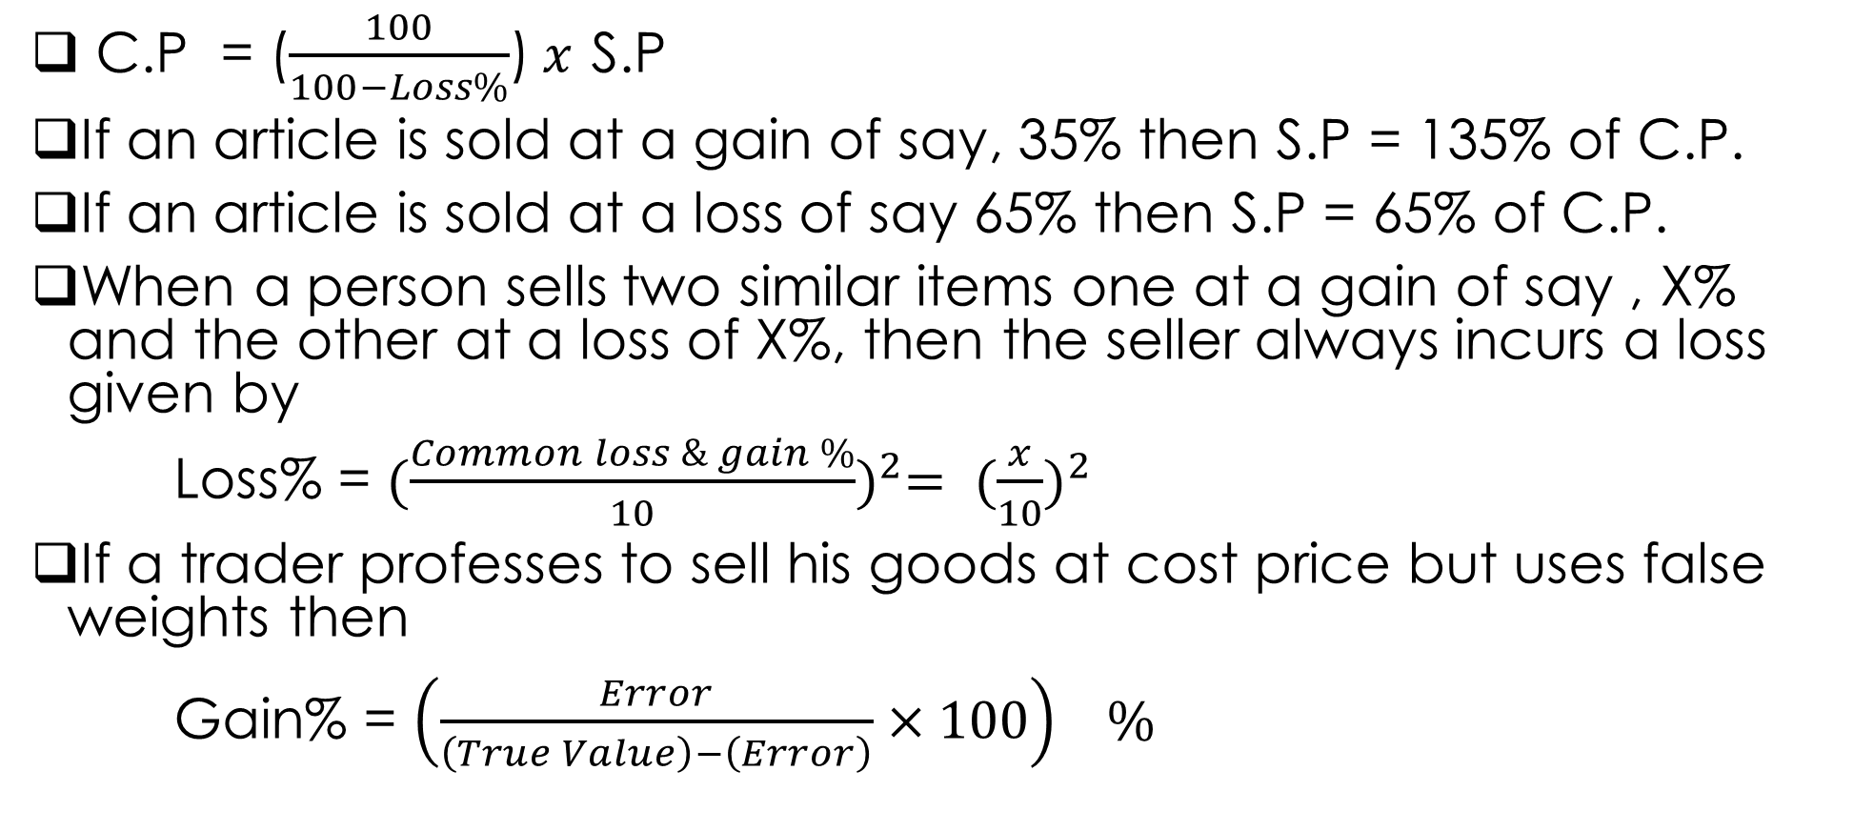
C.P = ($\frac{100}{100−Loss\%}$)$x$ S.P
If an article is sold at a gain of say, 35% then S.P = 135% of C.P.
If an article is sold at a loss of say 65% then S.P = 65% of C.P.
When a person sells two similar items one at a gain of say , X% and the other at a loss of X%, then the seller always incurs a loss given by
Loss% = ${(\frac{Common loss \& gain \%}{10})}^{2}= {(\frac{x}{10})}^{2}$
If a trader professes to sell his goods at cost price but uses false weights then
Gain% = ${\left(\frac{Error}{\left(True Value\right)−\left(Error\right)}×100\right)}^{}\%$

Slide 5
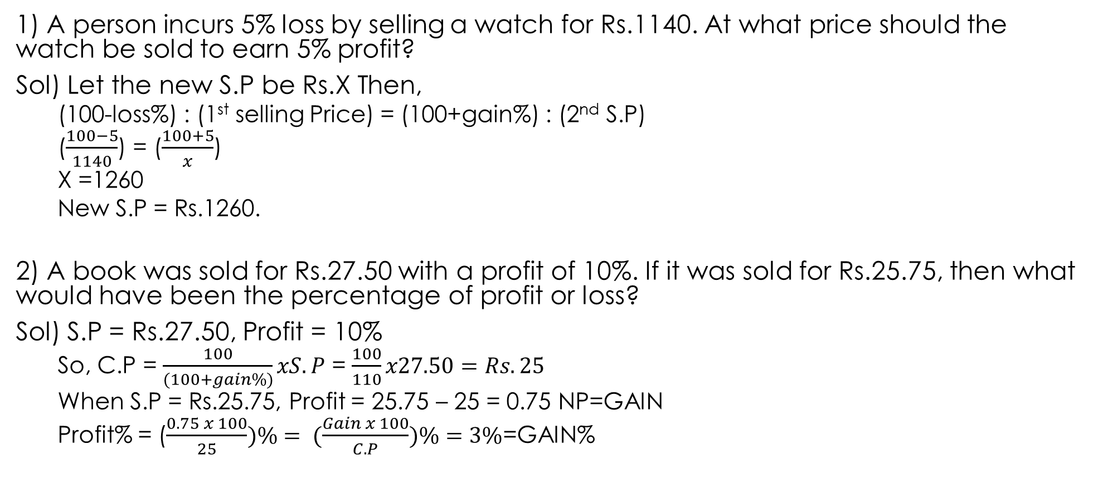
PROBLEMS
1) A person incurs 5% loss by selling a watch for Rs.1140. At what price should the watch be sold to earn 5% profit?
Sol) Let the new S.P be Rs.X Then,
(100-loss%) : (1st selling Price) = (100+gain%) : (2nd S.P)
($\frac{100−5}{1140}$) = ($\frac{100+5}{x}$)
X =1260
New S.P = Rs.1260.
2) A book was sold for Rs.27.50 with a profit of 10%. If it was sold for Rs.25.75, then what would have been the percentage of profit or loss?
Sol) S.P = Rs.27.50, Profit = 10%
So, C.P = $\frac{100}{(100+gain\%)}xS.P$ = $\frac{100}{110}x27.50=Rs. 25$
When S.P = Rs.25.75, Profit = 25.75 – 25 = 0.75 NP=GAIN
Profit% = ($\frac{0.75 x 100}{25})\%= (\frac{Gain x 100}{C.P})\%=3\%$=GAIN%

Slide 6
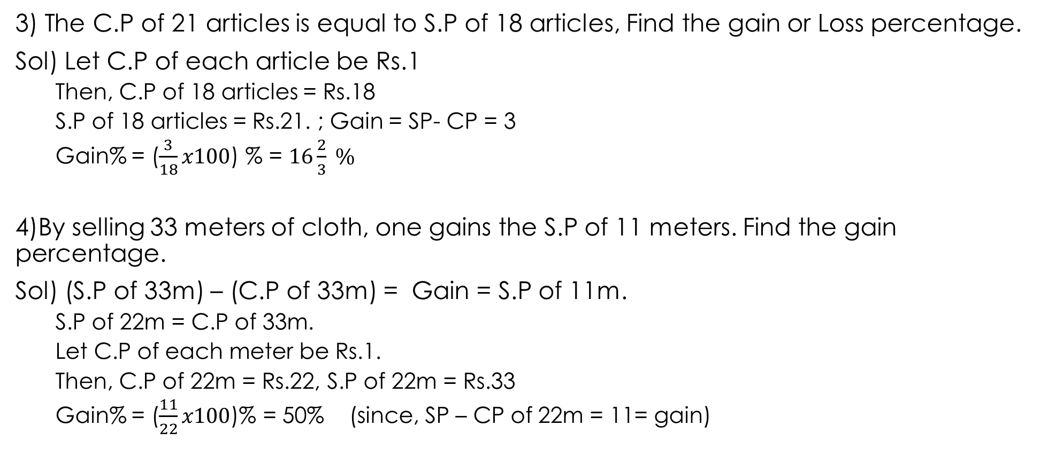
3) The C.P of 21 articles is equal to S.P of 18 articles, Find the gain or Loss percentage.
Sol) Let C.P of each article be Rs.1
Then, C.P of 18 articles = Rs.18
S.P of 18 articles = Rs.21. ; Gain = SP- CP = 3
Gain% = ($\frac{3}{18}x100$) % = $16\frac{2}{3} \%$
4)By selling 33 meters of cloth, one gains the S.P of 11 meters. Find the gain percentage.
Sol) (S.P of 33m) – (C.P of 33m) = Gain = S.P of 11m.
S.P of 22m = C.P of 33m.
Let C.P of each meter be Rs.1.
Then, C.P of 22m = Rs.22, S.P of 22m = Rs.33
Gain% = ($\frac{11}{22}x100$)% = 50% (since, SP – CP of 22m = 11= gain)

Slide 7
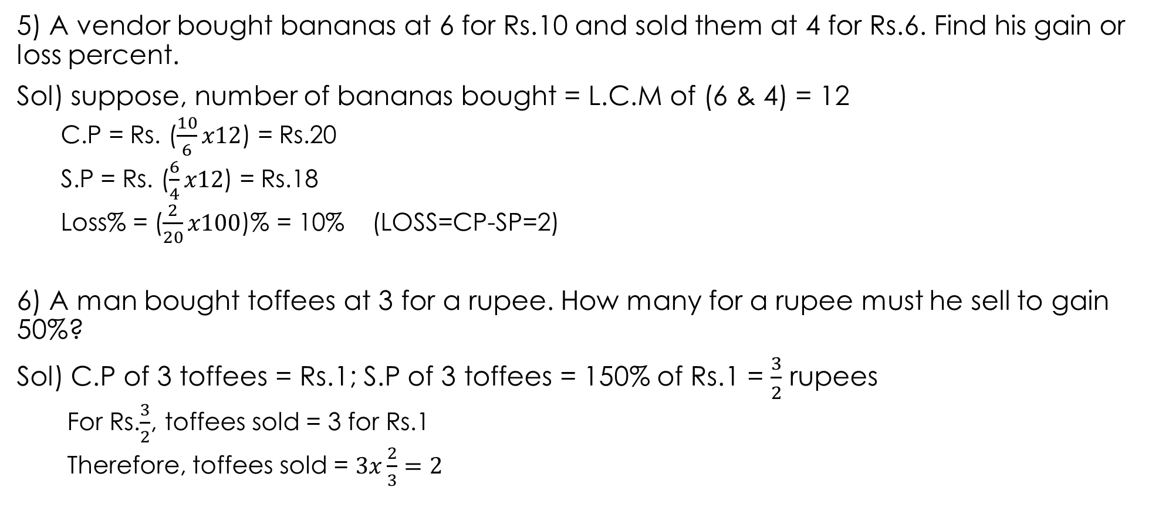
5) A vendor bought bananas at 6 for Rs.10 and sold them at 4 for Rs.6. Find his gain or loss percent.
Sol) suppose, number of bananas bought = L.C.M of (6 & 4) = 12
C.P = Rs. ($\frac{10}{6}x12$) = Rs.20
S.P = Rs. ($\frac{6}{4}x12$) = Rs.18
Loss% = ($\frac{2}{20}x100$)% = 10% (LOSS=CP-SP=2)
6) A man bought toffees at 3 for a rupee. How many for a rupee must he sell to gain 50%?
Sol) C.P of 3 toffees = Rs.1; S.P of 3 toffees = 150% of Rs.1 = $\frac{3}{2}$ rupees
For Rs.$\frac{3}{2}$, toffees sold = 3 for Rs.1
Therefore, toffees sold = $3x\frac{2}{3}=2$

Slide 8
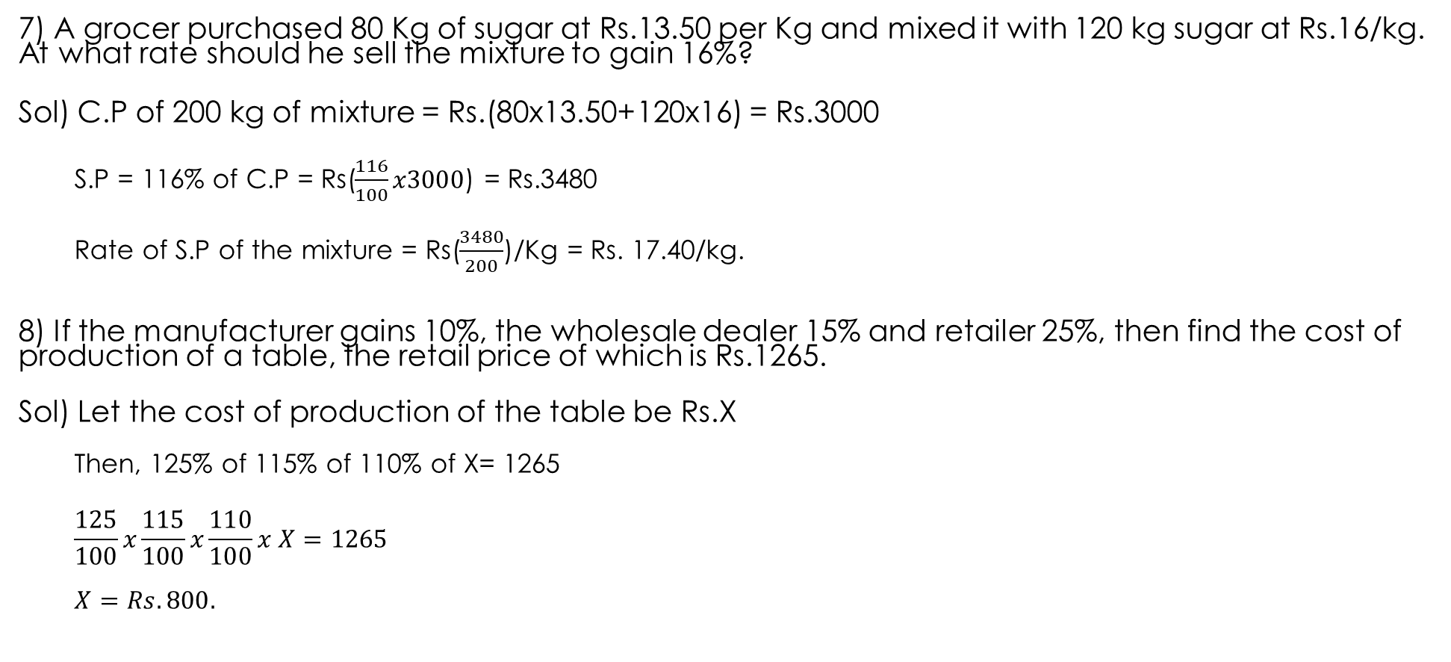
7) A grocer purchased 80 Kg of sugar at Rs.13.50 per Kg and mixed it with 120 kg sugar at Rs.16/kg. At what rate should he sell the mixture to gain 16%?
Sol) C.P of 200 kg of mixture = Rs.(80x13.50+120x16) = Rs.3000
S.P = 116% of C.P = Rs($\frac{116}{100}x3000$) = Rs.3480
Rate of S.P of the mixture = Rs($\frac{3480}{200}$)/Kg = Rs. 17.40/kg.
8) If the manufacturer gains 10%, the wholesale dealer 15% and retailer 25%, then find the cost of production of a table, the retail price of which is Rs.1265.
Sol) Let the cost of production of the table be Rs.X
Then, 125% of 115% of 110% of X= 1265
$$\frac{125}{100}x\frac{115}{100}x\frac{110}{100}x X=1265$$
$$X=Rs.800.$$

Slide 9
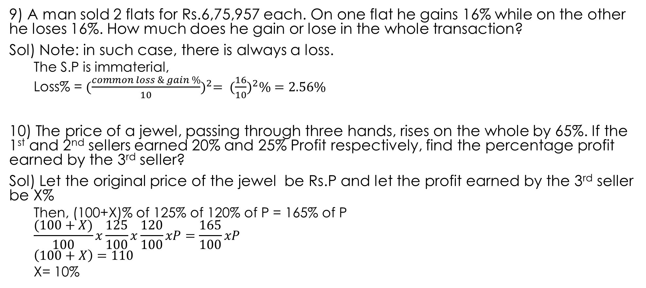
9) A man sold 2 flats for Rs.6,75,957 each. On one flat he gains 16% while on the other he loses 16%. How much does he gain or lose in the whole transaction?
Sol) Note: in such case, there is always a loss.
The S.P is immaterial,
Loss% = ${(\frac{common loss \& gain \%}{10})}^{2}= {(\frac{16}{10})}^{2}\%=2.56\%$
10) The price of a jewel, passing through three hands, rises on the whole by 65%. If the 1st and 2nd sellers earned 20% and 25% Profit respectively, find the percentage profit earned by the 3rd seller?
Sol) Let the original price of the jewel be Rs.P and let the profit earned by the 3rd seller be X%
Then, (100+X)% of 125% of 120% of P = 165% of P
$$\frac{(100+X)}{100}x\frac{125}{100}x\frac{120}{100}xP=\frac{165}{100}xP$$
$$\left(100+X\right)=110$$
X= 10%

Slide 10
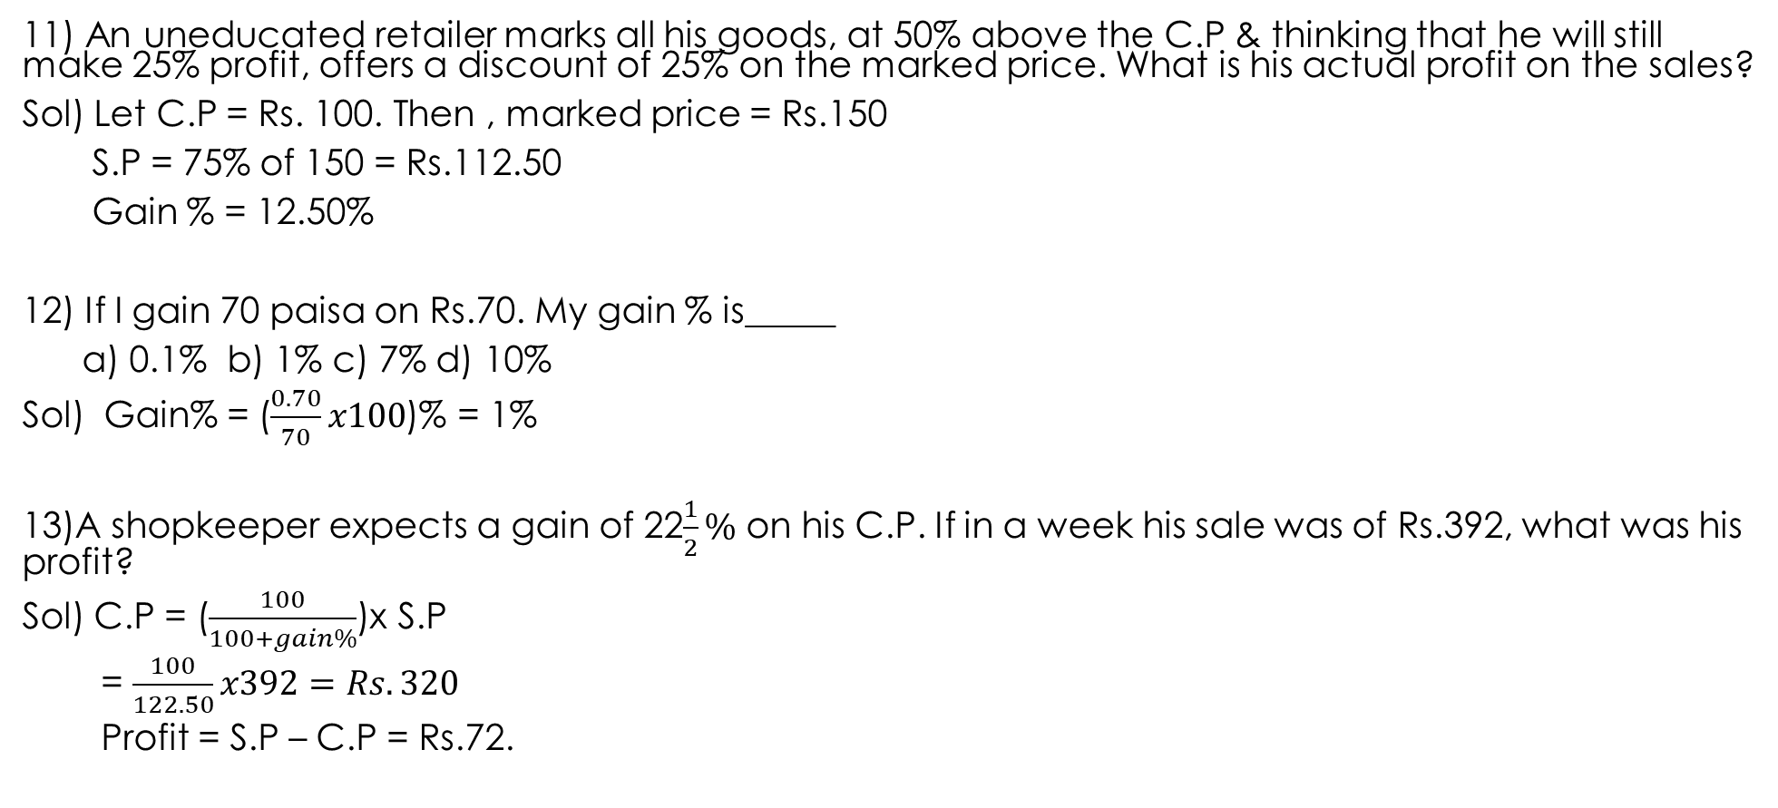
11) An uneducated retailer marks all his goods, at 50% above the C.P & thinking that he will still make 25% profit, offers a discount of 25% on the marked price. What is his actual profit on the sales?
Sol) Let C.P = Rs. 100. Then , marked price = Rs.150
S.P = 75% of 150 = Rs.112.50
Gain % = 12.50%
12) If I gain 70 paisa on Rs.70. My gain % is_____
a) 0.1% b) 1% c) 7% d) 10%
Sol) Gain% = ($\frac{0.70}{70}x100$)% = 1%
13)A shopkeeper expects a gain of 22$\frac{1}{2}\%$ on his C.P. If in a week his sale was of Rs.392, what was his profit?
Sol) C.P = ($\frac{100}{100+gain\%}$)x S.P
= $\frac{100}{122.50}x392=Rs.320$
Profit = S.P – C.P = Rs.72.

Slide 11
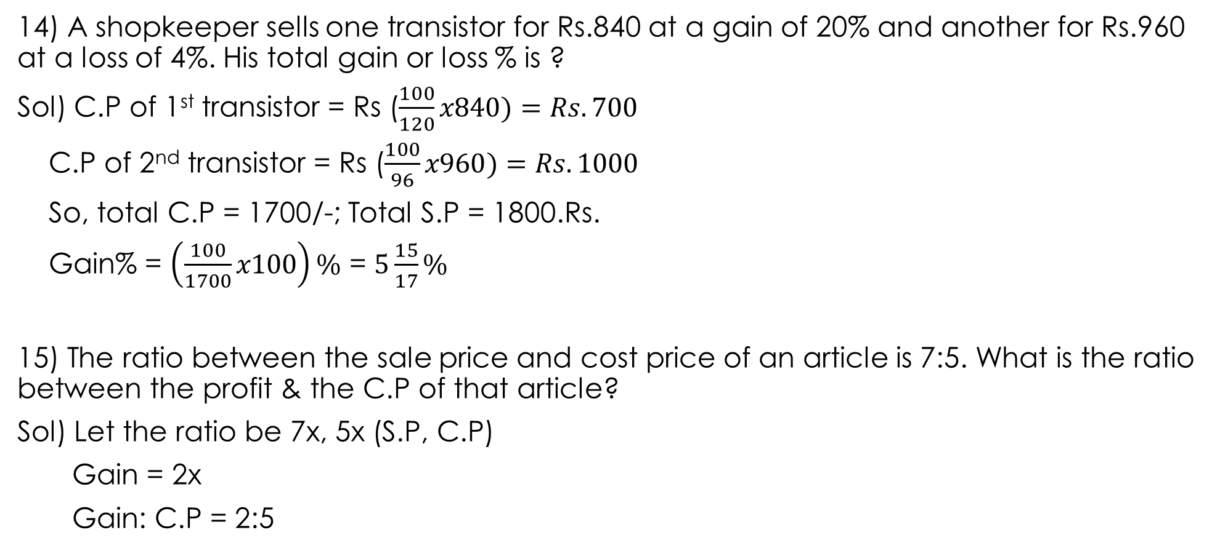
14) A shopkeeper sells one transistor for Rs.840 at a gain of 20% and another for Rs.960 at a loss of 4%. His total gain or loss % is ?
Sol) C.P of 1st transistor = Rs ($\frac{100}{120}x840)=Rs.700$
C.P of 2nd transistor = Rs ($\frac{100}{96}x960)=Rs.1000$
So, total C.P = 1700/-; Total S.P = 1800.Rs.
Gain% = $\left(\frac{100}{1700}x100\right)\%$ = $5\frac{15}{17}\%$
15) The ratio between the sale price and cost price of an article is 7:5. What is the ratio between the profit & the C.P of that article?
Sol) Let the ratio be 7x, 5x (S.P, C.P)
Gain = 2x
Gain: C.P = 2:5

Slide 12
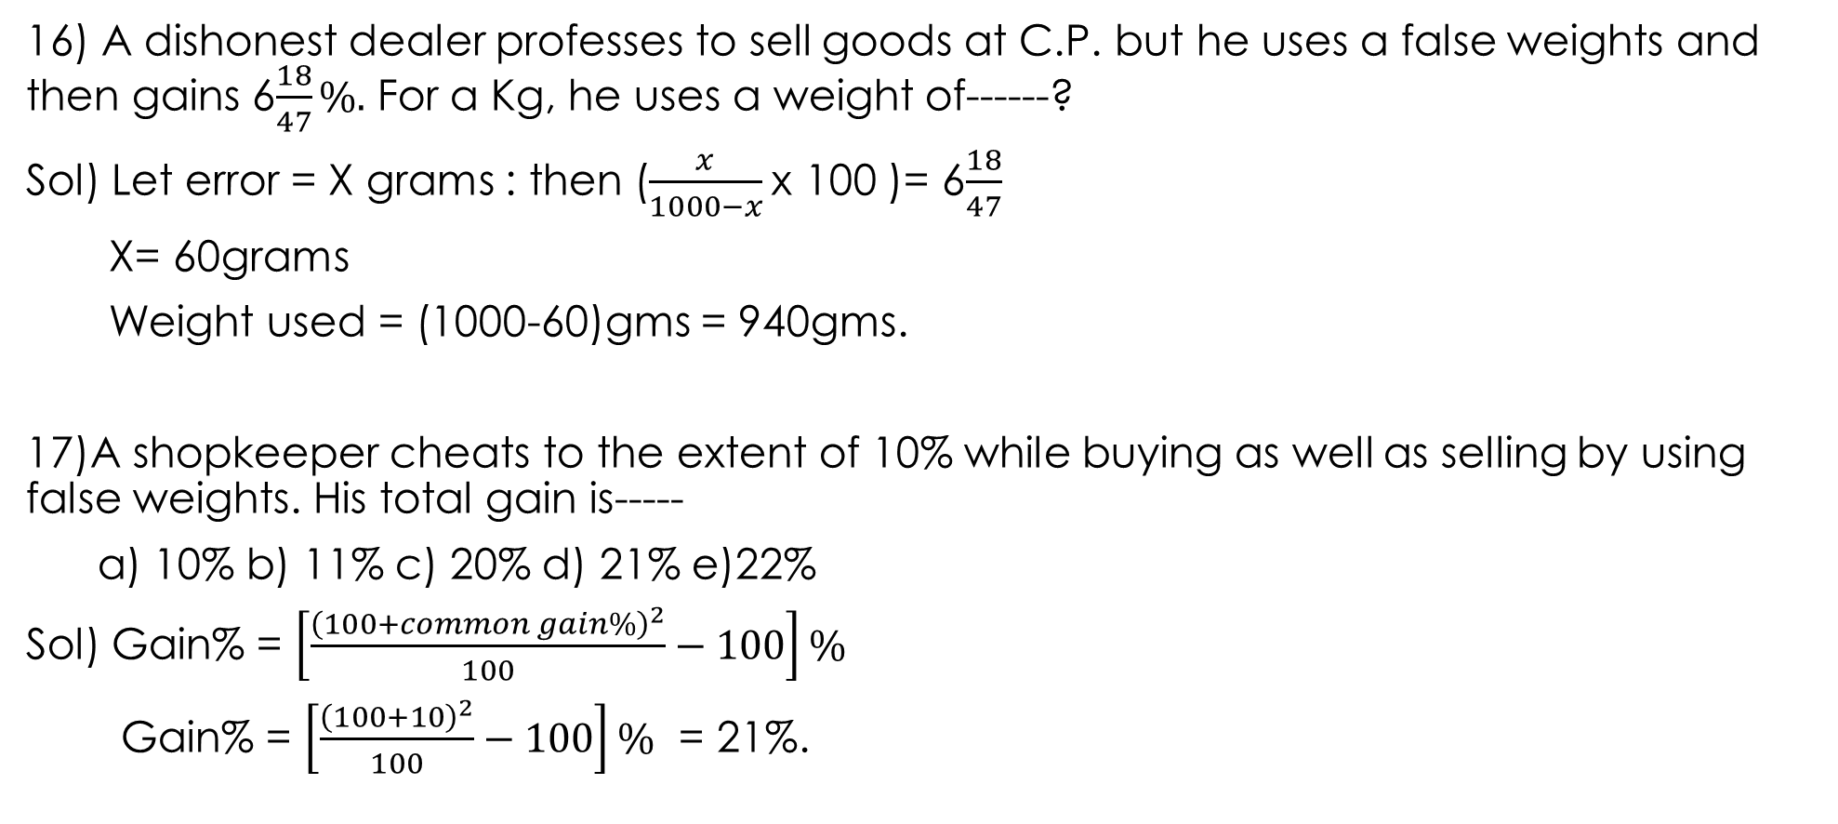
16) A dishonest dealer professes to sell goods at C.P. but he uses a false weights and then gains 6$\frac{18}{47}\%.$ For a Kg, he uses a weight of------?
Sol) Let error = X grams : then ($\frac{x}{1000−x}$x 100 )= 6$\frac{18}{47}$
X= 60grams
Weight used = (1000-60)gms = 940gms.
17)A shopkeeper cheats to the extent of 10% while buying as well as selling by using false weights. His total gain is-----
a) 10% b) 11% c) 20% d) 21% e)22%
Sol) Gain% = $\left[\frac{{\left(100+common gain\%\right)}^{2}}{100}−100\right]\%$
Gain% = $\left[\frac{{\left(100+10\right)}^{2}}{100}−100\right]\%$ = 21%.

Slide 13
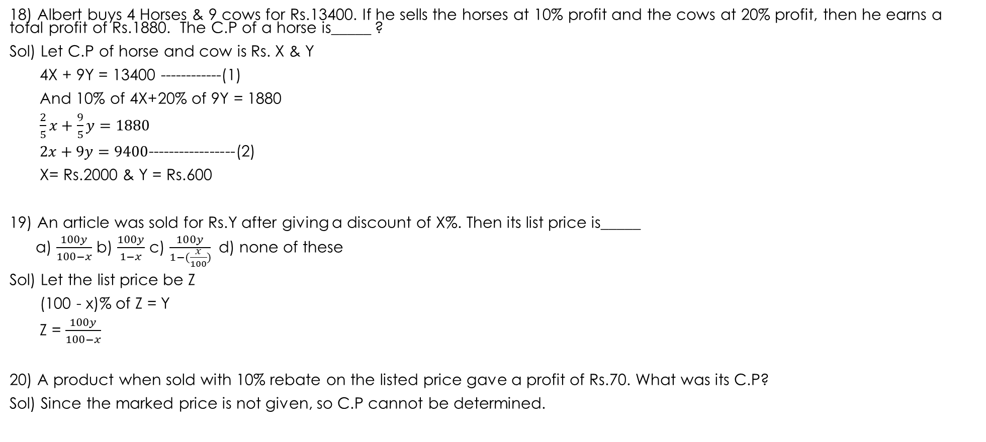
18) Albert buys 4 Horses & 9 cows for Rs.13400. If he sells the horses at 10% profit and the cows at 20% profit, then he earns a total profit of Rs.1880. The C.P of a horse is_____ ?
Sol) Let C.P of horse and cow is Rs. X & Y
4X + 9Y = 13400 ------------(1)
And 10% of 4X+20% of 9Y = 1880
$$\frac{2}{5}x+\frac{9}{5}y=1880$$
$2x+9y=9400$-----------------(2)
X= Rs.2000 & Y = Rs.600
19) An article was sold for Rs.Y after giving a discount of X%. Then its list price is_____
a) $\frac{100y}{100−x}$ b) $\frac{100y}{1−x}$ c) $\frac{100y}{1−(\frac{x}{100})}$ d) none of these
Sol) Let the list price be Z
(100 - x)% of Z = Y
Z = $\frac{100y}{100−x}$
20) A product when sold with 10% rebate on the listed price gave a profit of Rs.70. What was its C.P?
Sol) Since the marked price is not given, so C.P cannot be determined.

Slide 14
PARTNERSHIP
Important Facts & Formulae:
Partnership: When two or more than two persons run a business jointly, they are called partners and the deal is known as partnership.
Ratio of Division of Gains:
When investments of all the partners are for the same time, the gain or loss is distributed among the partners in the ratio of their investments. i.e., Suppose A & B invest Rs.X & Rs.Y respectively for a year in a business, then at the end of the year: (A’s share of profit) : (B’s share of profit) = X : Y
When investments are for different time periods, then equivalent capitals are calculated for a unit of time by taking (capital x number of units of time). Now, gain or loss is divided in the ratio of these capitals. i.e., Suppose A invests Rs. X for P months and B invests Rs.Y for Q months, then (A’s share of profit) : (B’s share of profit) = XP : YQ
Working and Sleeping Partners: A partner who manages the business is known as a working partner and the one who simply invests the money is a sleeping partner.

Slide 15
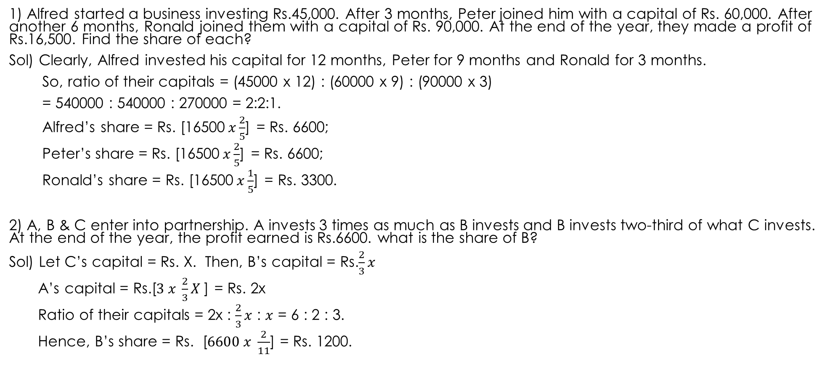
PROBLEMS
1) Alfred started a business investing Rs.45,000. After 3 months, Peter joined him with a capital of Rs. 60,000. After another 6 months, Ronald joined them with a capital of Rs. 90,000. At the end of the year, they made a profit of Rs.16,500. Find the share of each?
Sol) Clearly, Alfred invested his capital for 12 months, Peter for 9 months and Ronald for 3 months.
So, ratio of their capitals = (45000 x 12) : (60000 x 9) : (90000 x 3)
= 540000 : 540000 : 270000 = 2:2:1.
Alfred’s share = Rs. [16500$x\frac{2}{5}$] = Rs. 6600;
Peter’s share = Rs. [16500$x\frac{2}{5}$] = Rs. 6600;
Ronald’s share = Rs. [16500$x\frac{1}{5}$] = Rs. 3300.
2) A, B & C enter into partnership. A invests 3 times as much as B invests and B invests two-third of what C invests. At the end of the year, the profit earned is Rs.6600. what is the share of B?
Sol) Let C’s capital = Rs. X. Then, B’s capital = Rs.$\frac{2}{3}x$
A’s capital = Rs.[$3 x \frac{2}{3}X$] = Rs. 2x
Ratio of their capitals = 2x : $\frac{2}{3}x$ : $x$ = 6 : 2 : 3.
Hence, B’s share = Rs. [$6600 x \frac{2}{11}$] = Rs. 1200.

Slide 16
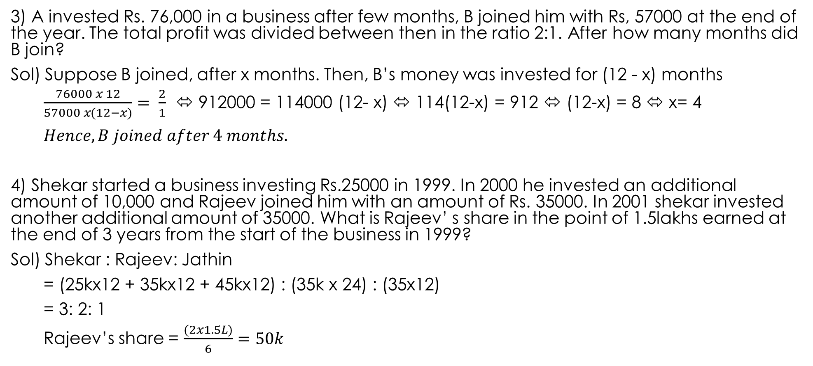
3) A invested Rs. 76,000 in a business after few months, B joined him with Rs, 57000 at the end of the year. The total profit was divided between then in the ratio 2:1. After how many months did B join?
Sol) Suppose B joined, after x months. Then, B’s money was invested for (12 - x) months
$\frac{76000 x 12}{57000 x(12−x)}= \frac{2}{1}$⬄ 912000 = 114000 (12- x) ⬄ 114(12-x) = 912 ⬄ (12-x) = 8 ⬄ x= 4
$$Hence, B joined after 4 months.$$
4) Shekar started a business investing Rs.25000 in 1999. In 2000 he invested an additional amount of 10,000 and Rajeev joined him with an amount of Rs. 35000. In 2001 shekar invested another additional amount of 35000. What is Rajeev’ s share in the point of 1.5lakhs earned at the end of 3 years from the start of the business in 1999?
Sol) Shekar : Rajeev: Jathin
= (25kx12 + 35kx12 + 45kx12) : (35k x 24) : (35x12)
= 3: 2: 1
Rajeev’s share = $\frac{(2x1.5L)}{6}=50k$

Slide 17
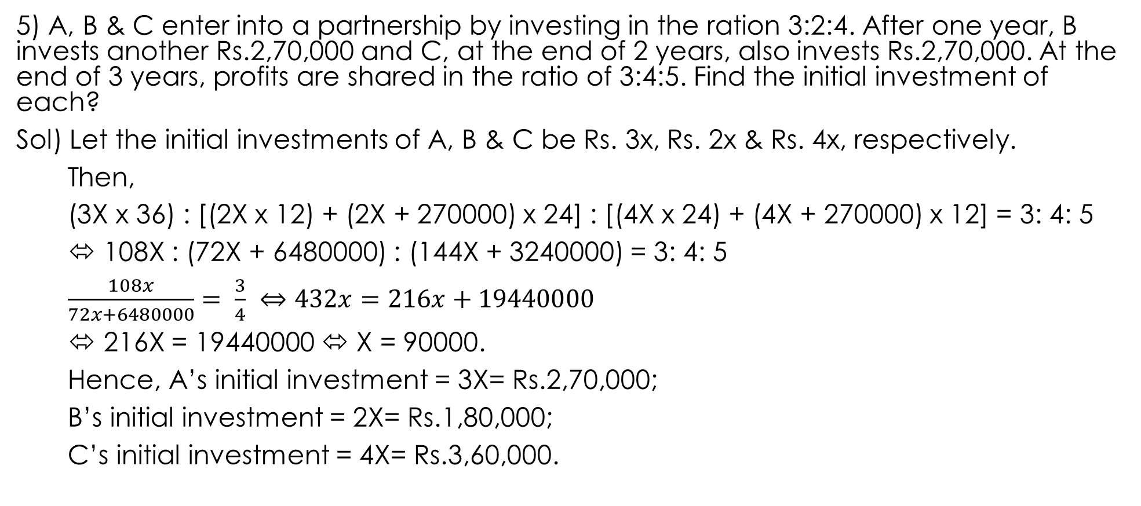
5) A, B & C enter into a partnership by investing in the ration 3:2:4. After one year, B invests another Rs.2,70,000 and C, at the end of 2 years, also invests Rs.2,70,000. At the end of 3 years, profits are shared in the ratio of 3:4:5. Find the initial investment of each?
Sol) Let the initial investments of A, B & C be Rs. 3x, Rs. 2x &Rs. 4x, respectively.
Then,
(3X x 36) : [(2X x 12) + (2X + 270000) x 24] : [(4X x 24) + (4X + 270000) x 12] = 3: 4: 5
⬄ 108X : (72X + 6480000) : (144X + 3240000) = 3: 4: 5
$$\frac{108x}{72x+6480000}= \frac{3}{4} ⇔432x=216x+19440000$$
⬄ 216X = 19440000 ⬄ X = 90000.
Hence, A’s initial investment = 3X= Rs.2,70,000;
B’s initial investment = 2X= Rs.1,80,000;
C’s initial investment = 4X= Rs.3,60,000.

Slide 18
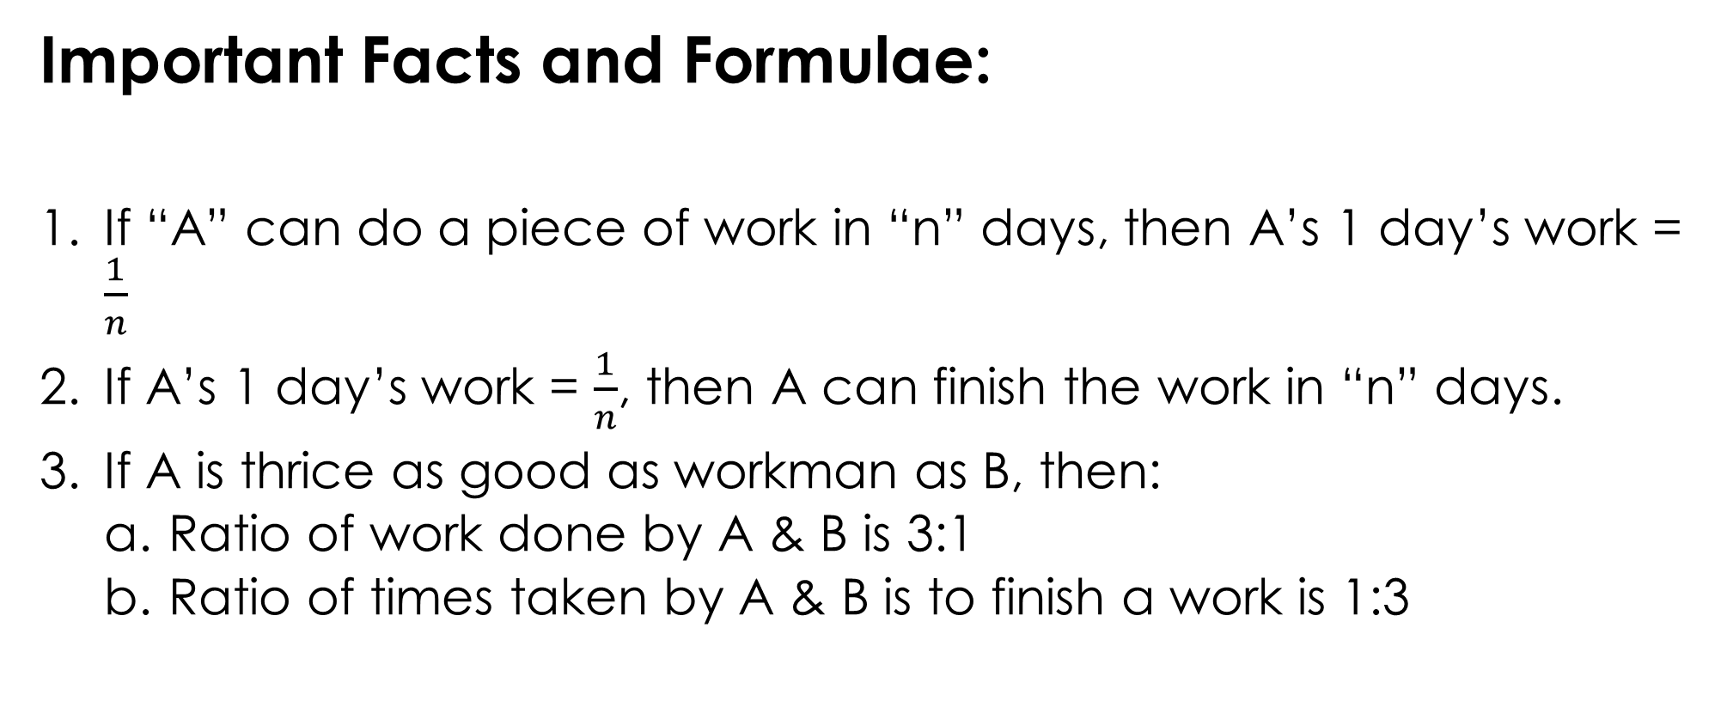
TIME AND WORK
Important Facts and Formulae:
If “A” can do a piece of work in “n” days, then A’s 1 day’s work = $\frac{1}{n}$
If A’s 1 day’s work = $\frac{1}{n}$, then A can finish the work in “n” days.
If A is thrice as good as workman as B, then:
Ratio of work done by A & B is 3:1
Ratio of times taken by A & B is to finish a work is 1:3

Slide 19
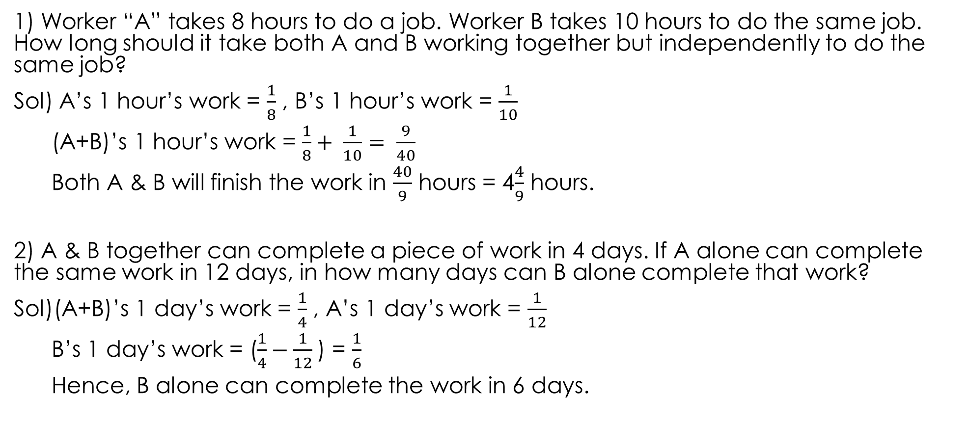
PROBLEMS
1) Worker “A” takes 8 hours to do a job. Worker B takes 10 hours to do the same job. How long should it take both A and B working together but independently to do the same job?
Sol) A’s 1 hour’s work = $\frac{1}{8}$ , B’s 1 hour’s work = $\frac{1}{10}$
(A+B)’s 1 hour’s work = $\frac{1}{8}+ \frac{1}{10}= \frac{9}{40}$
Both A & B will finish the work in $\frac{40}{9}$ hours = 4$\frac{4}{9}$ hours.
2) A & B together can complete a piece of work in 4 days. If A alone can complete the same work in 12 days, in how many days can B alone complete that work?
Sol)(A+B)’s 1 day’s work = $\frac{1}{4}$ , A’s 1 day’s work = $\frac{1}{12}$
B’s 1 day’s work = ($\frac{1}{4}−\frac{1}{12}$) = $\frac{1}{6}$
Hence, B alone can complete the work in 6 days.

Slide 20
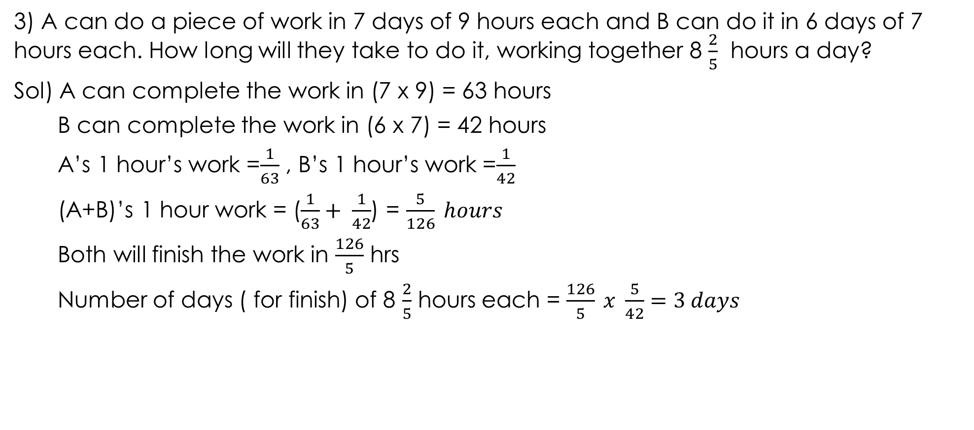
3) A can do a piece of work in 7 days of 9 hours each and B can do it in 6 days of 7 hours each. How long will they take to do it, working together 8 $\frac{2}{5}$ hours a day?
Sol) A can complete the work in (7 x 9) = 63 hours
B can complete the work in (6 x 7) = 42 hours
A’s 1 hour’s work =$\frac{1}{63}$ , B’s 1 hour’s work =$\frac{1}{42}$
(A+B)’s 1 hour work = ($\frac{1}{63}+ \frac{1}{42}$) = $\frac{5}{126} hours$
Both will finish the work in $\frac{126}{5}$ hrs
Number of days ( for finish) of 8 $\frac{2}{5}$ hours each = $\frac{126}{5} x \frac{5}{42}=3 days$

Slide 21
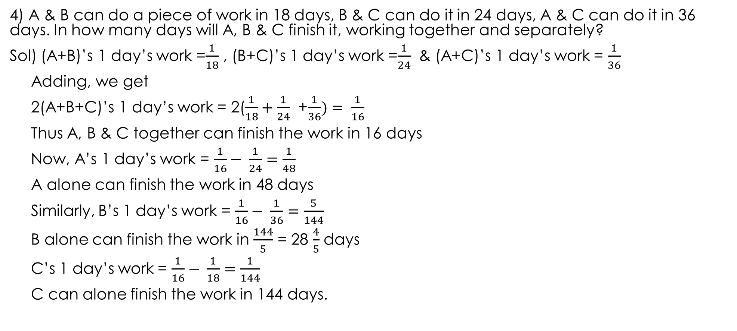
4) A & B can do a piece of work in 18 days, B & C can do it in 24 days, A & C can do it in 36 days. In how many days will A, B & C finish it, working together and separately?
Sol) (A+B)’s 1 day’s work =$\frac{1}{18}$ , (B+C)’s 1 day’s work =$\frac{1}{24}$& (A+C)’s 1 day’s work = $\frac{1}{36}$
Adding, we get
2(A+B+C)’s 1 day’s work = 2($\frac{1}{18}+\frac{1}{24}$ +$\frac{1}{36})= \frac{1}{16}$
Thus A, B & C together can finish the work in 16 days
Now, A’s 1 day’s work = $\frac{1}{16}− \frac{1}{24}=\frac{1}{48}$
A alone can finish the work in 48 days
Similarly, B’s 1 day’s work = $\frac{1}{16}− \frac{1}{36}=\frac{5}{144}$
B alone can finish the work in $\frac{144}{5}$ = 28 $\frac{4}{5}$ days
C’s 1 day’s work = $\frac{1}{16}− \frac{1}{18}=\frac{1}{144}$
C can alone finish the work in 144 days.

Slide 22
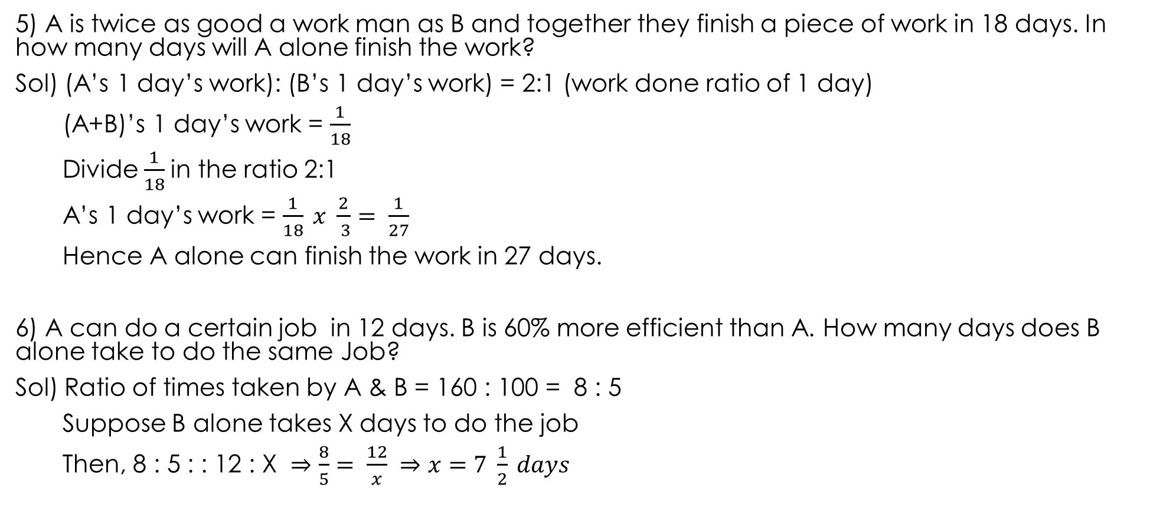
5) A is twice as good a work man as B and together they finish a piece of work in 18 days. In how many days will A alone finish the work?
Sol) (A’s 1 day’s work): (B’s 1 day’s work) = 2:1 (work done ratio of 1 day)
(A+B)’s 1 day’s work = $\frac{1}{18}$
Divide $\frac{1}{18}$in the ratio 2:1
A’s 1 day’s work = $\frac{1}{18} x \frac{2}{ 3}= \frac{1}{27}$
Hence A alone can finish the work in 27 days.
6) A can do a certain job in 12 days. B is 60% more efficient than A. How many days does B alone take to do the same Job?
Sol) Ratio of times taken by A & B = 160 : 100 = 8 : 5
Suppose B alone takes X days to do the job
Then, 8 : 5 : : 12 : X ⇒ $\frac{8}{5}= \frac{12}{x} ⇒x=7 \frac{1}{2} days$

Slide 23
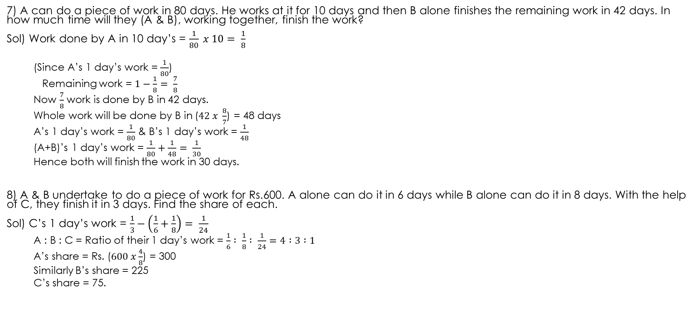
7) A can do a piece of work in 80 days. He works at it for 10 days and then B alone finishes the remaining work in 42 days. In how much time will they (A & B), working together, finish the work?
Sol) Work done by A in 10 day’s = $\frac{1}{80} x 10= \frac{1}{8}$
(Since A’s 1 day’s work = $\frac{1}{80}$)
Remaining work = $1−\frac{1}{8}= \frac{7}{8}$
Now $\frac{7}{8}$ work is done by B in 42 days.
Whole work will be done by B in ($42 x \frac{8}{7}$) = 48 days
A’s 1 day’s work = $\frac{1}{80}$& B’s 1 day’s work = $\frac{1}{48}$
(A+B)’s 1 day’s work = $\frac{1}{80}+\frac{1}{48}= \frac{1}{30}$
Hence both will finish the work in 30 days.
8) A & B undertake to do a piece of work for Rs.600. A alone can do it in 6 days while B alone can do it in 8 days. With the help of C, they finish it in 3 days. Find the share of each.
Sol) C’s 1 day’s work = $\frac{1}{3}−\left(\frac{1}{6}+\frac{1}{8}\right)= \frac{1}{24}$
A : B : C = Ratio of their 1 day’s work = $\frac{1}{6} : \frac{1}{8} : \frac{1}{24}=4 :3 :1$
A’s share = Rs. ($600 x\frac{4}{8}$) = 300
Similarly B’s share = 225
C’s share = 75.

Slide 24
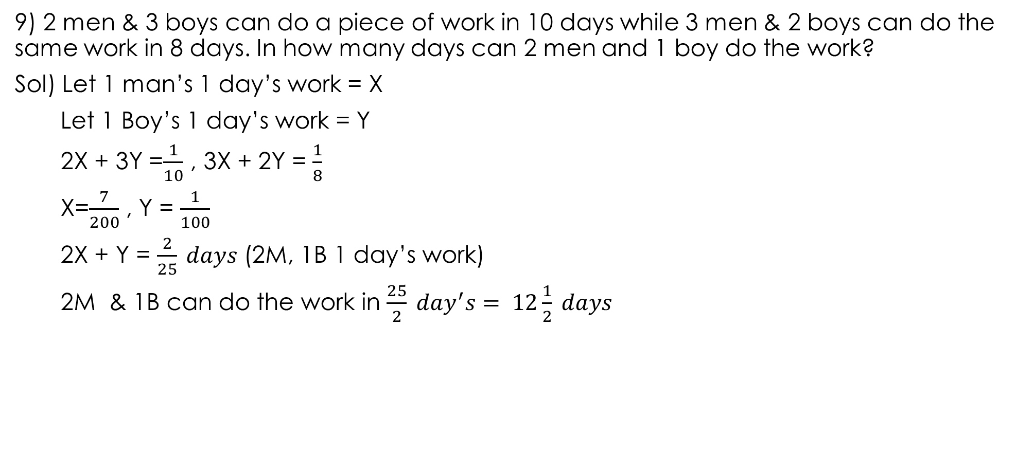
9) 2 men & 3 boys can do a piece of work in 10 days while 3 men & 2 boys can do the same work in 8 days. In how many days can 2 men and 1 boy do the work?
Sol) Let 1 man’s 1 day’s work = X
Let 1 Boy’s 1 day’s work = Y
2X + 3Y =$\frac{1}{10}$ , 3X + 2Y = $\frac{1}{8}$
X=$\frac{7}{200}$ , Y = $\frac{1}{100}$
2X + Y = $\frac{2}{25} days$ (2M, 1B 1 day’s work)
2M & 1B can do the work in $\frac{25}{2} day^{′}s= 12\frac{1}{2} days$

Slide 25
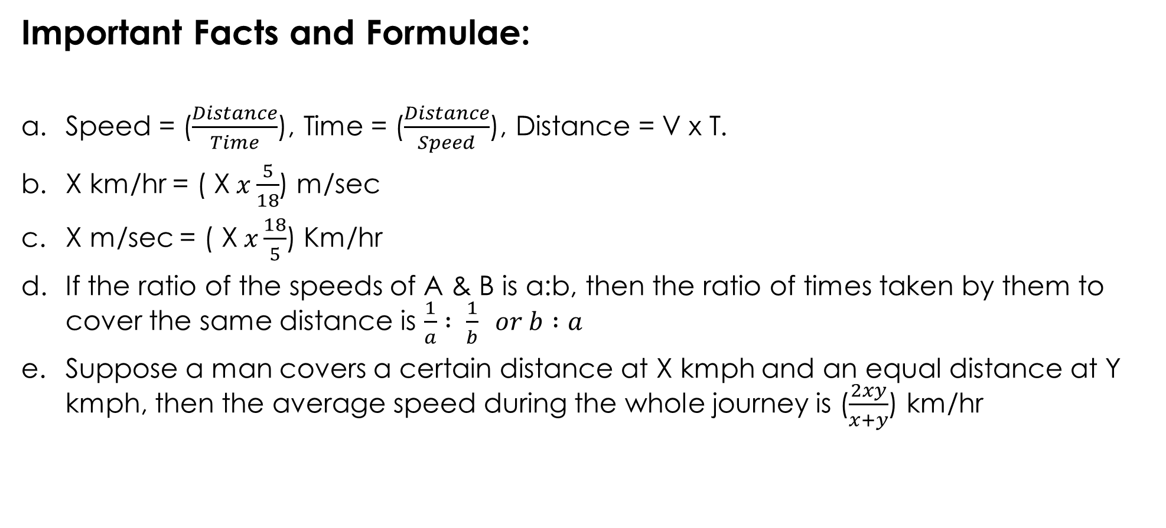
TIME AND DISTANCE
Important Facts and Formulae:
Speed = ($\frac{Distance}{Time}$), Time = ($\frac{Distance}{Speed}$), Distance = V x T.
X km/hr = ( X$x\frac{5}{18}$) m/sec
X m/sec = ( X$x\frac{18}{5}$) Km/hr
If the ratio of the speeds of A & B is a:b, then the ratio of times taken by them to cover the same distance is $\frac{1}{a} : \frac{1}{b} or b :a$
Suppose a man covers a certain distance at X kmph and an equal distance at Y kmph, then the average speed during the whole journey is ($\frac{2xy}{x+y}$) km/hr

Slide 26
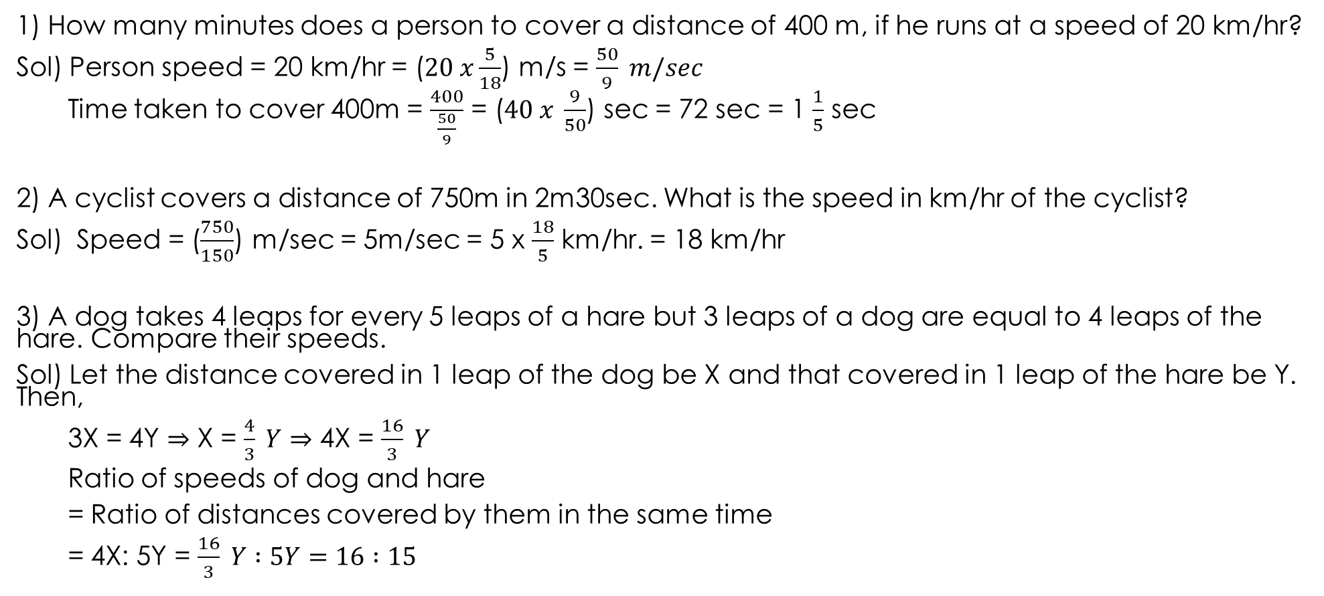
PROBLEMS
1) How many minutes does a person to cover a distance of 400 m, if he runs at a speed of 20 km/hr?
Sol) Person speed = 20 km/hr = ($20 x\frac{5}{18}$) m/s = $\frac{50}{9} m/sec$
Time taken to cover 400m = $\frac{400}{\frac{50}{9}}$ = ($40 x \frac{9}{50}$) sec = 72 sec = 1 $\frac{1}{5}$ sec
2) A cyclist covers a distance of 750m in 2m30sec. What is the speed in km/hr of the cyclist?
Sol) Speed = ($\frac{750}{150}$) m/sec = 5m/sec = 5 x $\frac{18}{5}$ km/hr. = 18 km/hr
3) A dog takes 4 leaps for every 5 leaps of a hare but 3 leaps of a dog are equal to 4 leaps of the hare. Compare their speeds.
Sol) Let the distance covered in 1 leap of the dog be X and that covered in 1 leap of the hare be Y. Then,
3X = 4Y ⇒ X = $\frac{4}{3} Y$ ⇒ 4X = $\frac{16}{3} Y$
Ratio of speeds of dog and hare
= Ratio of distances covered by them in the same time
= 4X: 5Y = $\frac{16}{3} Y :5Y=16 :15$

Slide 27
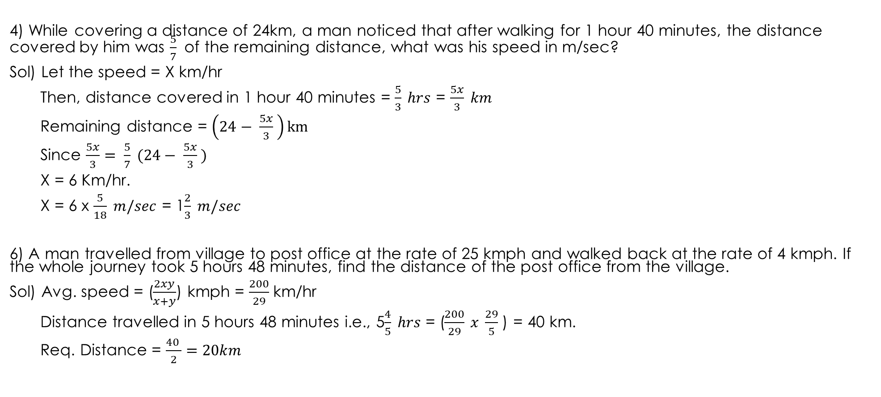
4) While covering a distance of 24km, a man noticed that after walking for 1 hour 40 minutes, the distance covered by him was $\frac{5}{7}$ of the remaining distance, what was his speed in m/sec?
Sol) Let the speed = X km/hr
Then, distance covered in 1 hour 40 minutes = $\frac{5}{3} hrs$ = $\frac{5x}{3} km$
Remaining distance = $\left(24− \frac{5x}{3} \right)km$
Since $\frac{5x}{3}= \frac{5}{7} (24− \frac{5x}{3} )$
X = 6 Km/hr.
X = 6 x $\frac{5}{18} m/sec$ = 1$\frac{2}{3} m/sec$
6) A man travelled from village to post office at the rate of 25 kmph and walked back at the rate of 4 kmph. If the whole journey took 5 hours 48 minutes, find the distance of the post office from the village.
Sol) Avg. speed = ($\frac{2xy}{x+y}$) kmph = $\frac{200}{29}$ km/hr
Distance travelled in 5 hours 48 minutes i.e., 5$\frac{4}{5} hrs$ = ($\frac{200}{29} x \frac{29}{5}$) = 40 km.
Req. Distance = $\frac{40 }{2}=20km$

Slide 28
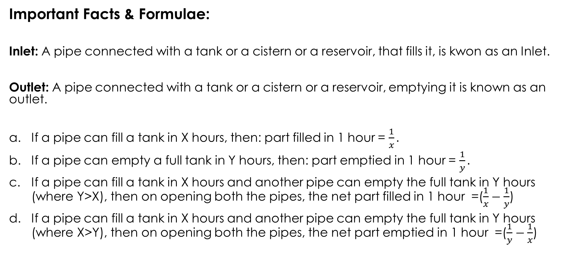
PIPES AND CISTERNS
Important Facts & Formulae:
Inlet: A pipe connected with a tank or a cistern or a reservoir, that fills it, is kwon as an Inlet.
Outlet: A pipe connected with a tank or a cistern or a reservoir, emptying it is known as an outlet.
If a pipe can fill a tank in X hours, then: part filled in 1 hour = $\frac{1}{x}.$
If a pipe can empty a full tank in Y hours, then: part emptied in 1 hour = $\frac{1}{y}.$
If a pipe can fill a tank in X hours and another pipe can empty the full tank in Y hours (where Y>X), then on opening both the pipes, the net part filled in 1 hour =($\frac{1}{x}−\frac{1}{y}$)
If a pipe can fill a tank in X hours and another pipe can empty the full tank in Y hours (where X>Y), then on opening both the pipes, the net part emptied in 1 hour =($\frac{1}{y}−\frac{1}{x}$)

Slide 29
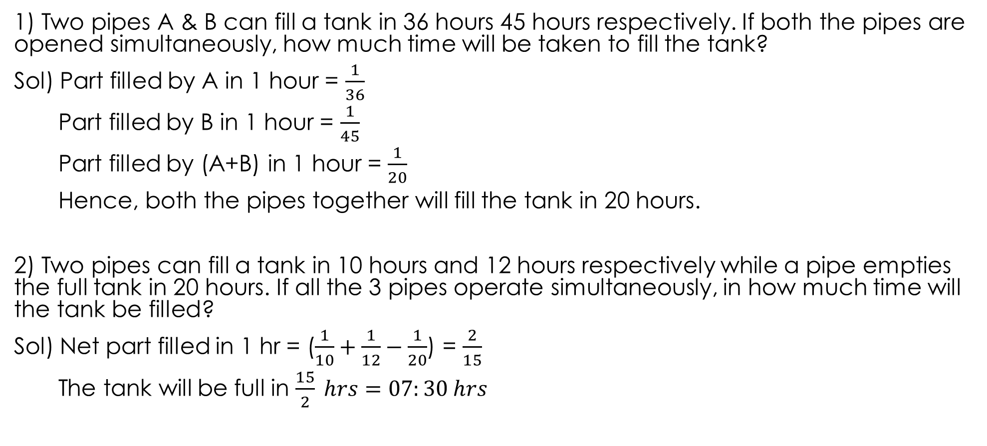
PROBLEMS
1) Two pipes A & B can fill a tank in 36 hours 45 hours respectively. If both the pipes are opened simultaneously, how much time will be taken to fill the tank?
Sol) Part filled by A in 1 hour = $\frac{1}{36}$
Part filled by B in 1 hour = $\frac{1}{45}$
Part filled by (A+B) in 1 hour = $\frac{1}{20}$
Hence, both the pipes together will fill the tank in 20 hours.
2) Two pipes can fill a tank in 10 hours and 12 hours respectively while a pipe empties the full tank in 20 hours. If all the 3 pipes operate simultaneously, in how much time will the tank be filled?
Sol) Net part filled in 1 hr = ($\frac{1}{10}+\frac{1}{12}−\frac{1}{20}$) = $\frac{2}{15}$
The tank will be full in $\frac{15}{2} hrs=07:30 hrs$

Slide 30
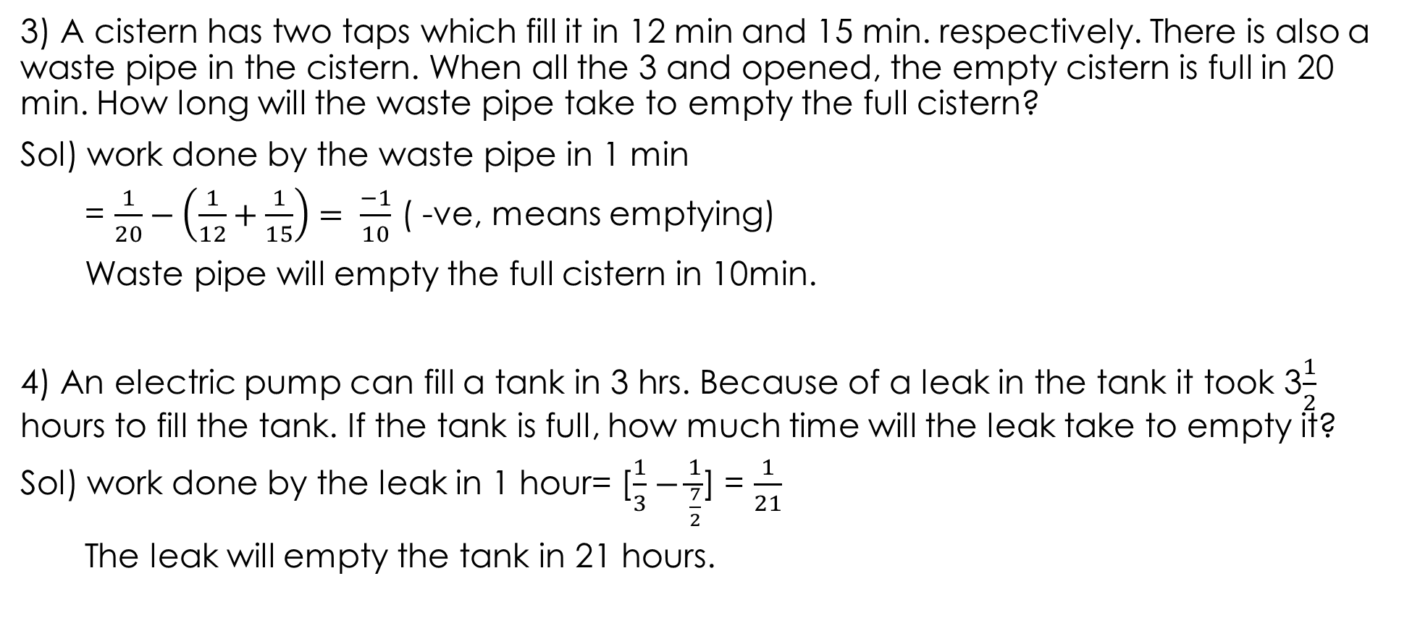
3) A cistern has two taps which fill it in 12 min and 15 min. respectively. There is also a waste pipe in the cistern. When all the 3 and opened, the empty cistern is full in 20 min. How long will the waste pipe take to empty the full cistern?
Sol) work done by the waste pipe in 1 min
= $\frac{1}{20}−\left(\frac{1}{12}+\frac{1}{15}\right)= \frac{−1}{10}$ ( -ve, means emptying)
Waste pipe will empty the full cistern in 10min.
4) An electric pump can fill a tank in 3 hrs. Because of a leak in the tank it took 3$\frac{1}{2}$ hours to fill the tank. If the tank is full, how much time will the leak take to empty it?
Sol) work done by the leak in 1 hour= [$\frac{1}{3}−\frac{1}{\frac{7}{2}}$] = $\frac{1}{21}$
The leak will empty the tank in 21 hours.

Slide 31
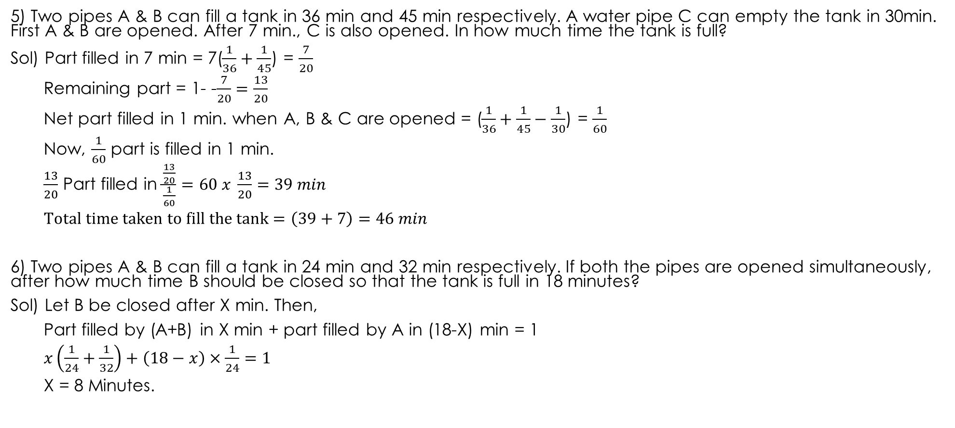
5) Two pipes A & B can fill a tank in 36 min and 45 min respectively. A water pipe C can empty the tank in 30min. First A & B are opened. After 7 min., C is also opened. In how much time the tank is full?
Sol) Part filled in 7 min = 7($\frac{1}{36}+\frac{1}{45}$) = $\frac{7}{20}$
Remaining part = 1- -$\frac{7}{20}=\frac{13}{20}$
Net part filled in 1 min. when A, B & C are opened = ($\frac{1}{36}+\frac{1}{45}−\frac{1}{30}$) = $\frac{1}{60}$
Now, $\frac{1}{60}$ part is filled in 1 min.
$\frac{13}{20}$ Part filled in $\frac{\frac{13}{20}}{\frac{1}{60}}=60 x \frac{13}{20}=39 min$
$$Total time taken to fill the tank=\left(39+7\right)=46 min$$
6) Two pipes A & B can fill a tank in 24 min and 32 min respectively. If both the pipes are opened simultaneously, after how much time B should be closed so that the tank is full in 18 minutes?
Sol) Let B be closed after X min. Then,
Part filled by (A+B) in X min + part filled by A in (18-X) min = 1
$$x\left(\frac{1}{24}+\frac{1}{32}\right)+\left(18−x\right)×\frac{1}{24}=1$$
X = 8 Minutes.

Slide 32
PROBLEMS ON TRAINS
Important Facts and Formulae:
Time taken by a train of length “l” meters to pass a pole or a standing man or a signal past is equal to the time taken by the train to cover “l” meters.
Time taken by a train of length “l” meters to pass a stationary object of length “b” meters is the time taken by the train to cover (l+b) meters.
Suppose two trains or two bodies are moving in the same direction at “u”m/sec, “𝓋”m/sec. where u>𝓋, then their relative speed = (u- 𝓋) m/sec.
Suppose two trains or two bodies are moving in the opposite directions at “u”m/sec, “𝓋”m/sec, then their relative speed = (u + 𝓋) m/sec.

Slide 33
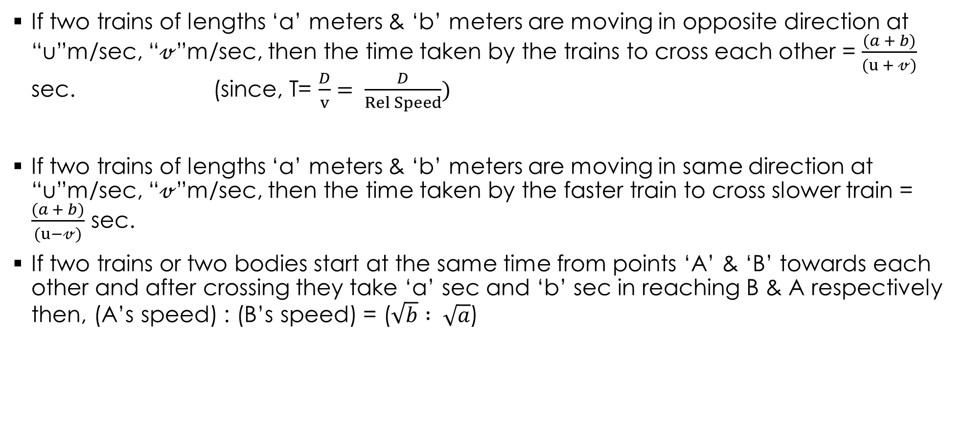
If two trains of lengths ‘a’ meters & ‘b’ meters are moving in opposite direction at “u”m/sec, “𝓋”m/sec, then the time taken by the trains to cross each other = $\frac{(a + b)}{(u + 𝓋)}$ sec. (since, T= $\frac{D}{v}= \frac{D}{Rel Speed})$
If two trains of lengths ‘a’ meters & ‘b’ meters are moving in same direction at “u”m/sec, “𝓋”m/sec, then the time taken by the faster train to cross slower train = $\frac{(a + b)}{(u−𝓋)}$ sec.
If two trains or two bodies start at the same time from points ‘A’ & ‘B’ towards each other and after crossing they take ‘a’ sec and ‘b’ sec in reaching B & A respectively then, (A’s speed) : (B’s speed) = ($\sqrt{b} : \sqrt{a}$)

Slide 34
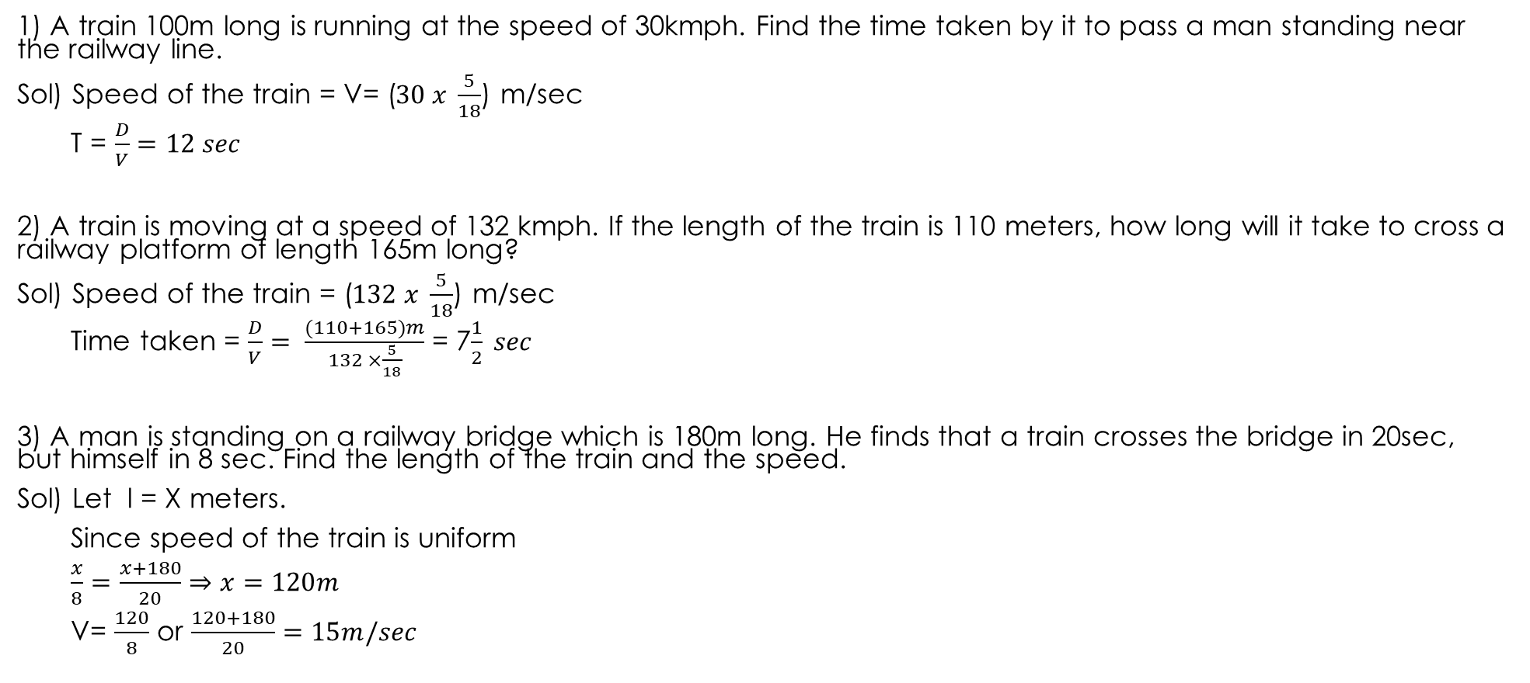
PROBLEMS
1) A train 100m long is running at the speed of 30kmph. Find the time taken by it to pass a man standing near the railway line.
Sol) Speed of the train = V= ($30 x \frac{5}{18}$) m/sec
T = $\frac{D}{V}=12 sec$
2) A train is moving at a speed of 132 kmph. If the length of the train is 110 meters, how long will it take to cross a railway platform of length 165m long?
Sol) Speed of the train = ($132 x \frac{5}{18}$) m/sec
Time taken = $\frac{D}{V}= \frac{(110+165)m}{132 ×\frac{5}{18}}$ = 7$\frac{1}{2} sec$
3) A man is standing on a railway bridge which is 180m long. He finds that a train crosses the bridge in 20sec, but himself in 8 sec. Find the length of the train and the speed.
Sol) Let l = X meters.
Since speed of the train is uniform
$$\frac{x}{8}=\frac{x+180}{20}⇒x=120m$$
V= $\frac{120}{8}$ or $\frac{120+180}{20}=15m/sec$

Slide 35
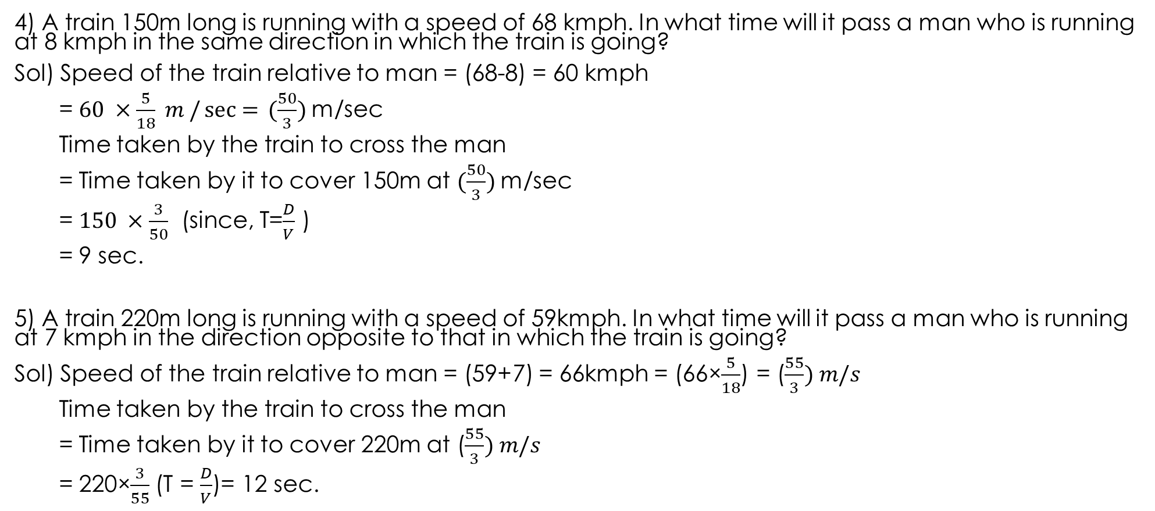
4) A train 150m long is running with a speed of 68 kmph. In what time will it pass a man who is running at 8 kmph in the same direction in which the train is going?
Sol) Speed of the train relative to man = (68-8) = 60 kmph
= $60 ×\frac{5}{18} m /\sec{=} (\frac{50}{3})$m/sec
Time taken by the train to cross the man
= Time taken by it to cover 150m at $(\frac{50}{3})$m/sec
= $150 ×\frac{3}{50}$ (since, T=$\frac{D}{V}$ )
= 9 sec.
5) A train 220m long is running with a speed of 59kmph. In what time will it pass a man who is running at 7 kmph in the direction opposite to that in which the train is going?
Sol) Speed of the train relative to man = (59+7) = 66kmph = (66×$\frac{5}{18}$) = ($\frac{55}{3}) m/s$
Time taken by the train to cross the man
= Time taken by it to cover 220m at ($\frac{55}{3}) m/s$
= 220×$\frac{3}{55}$(T = $\frac{D}{V}$)= 12 sec.

Slide 36
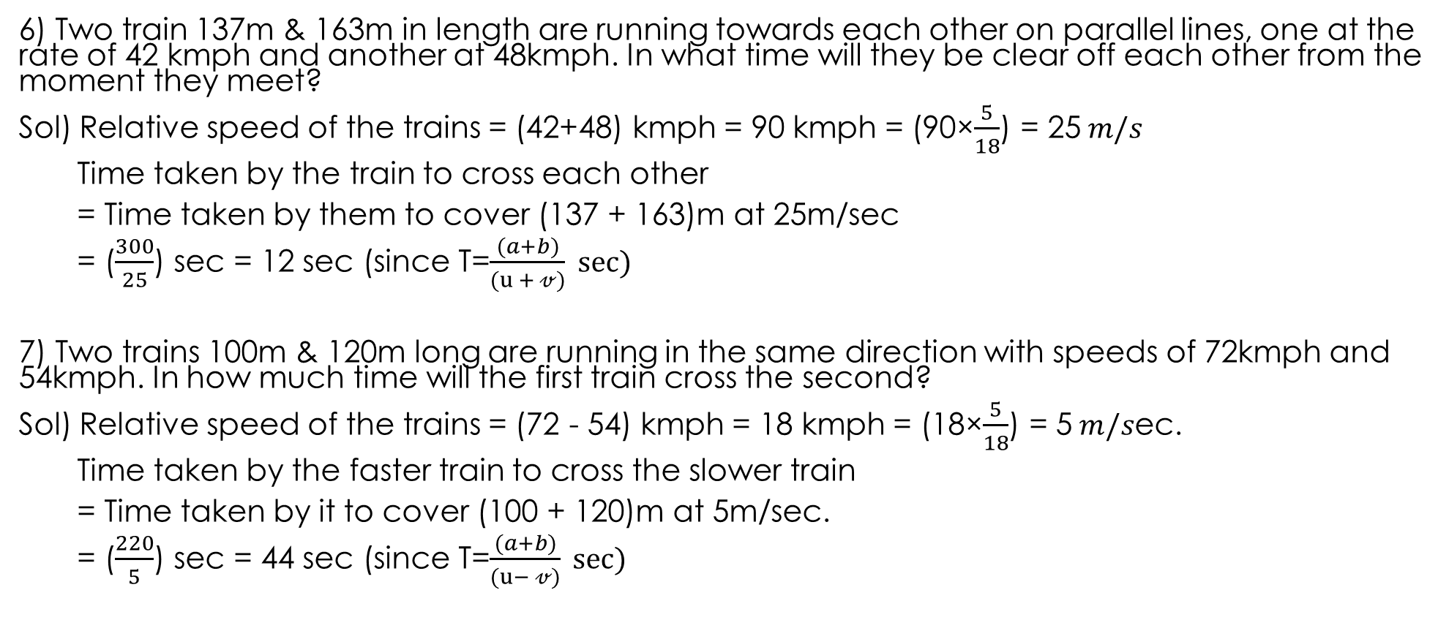
6) Two train 137m & 163m in length are running towards each other on parallel lines, one at the rate of 42 kmph and another at 48kmph. In what time will they be clear off each other from the moment they meet?
Sol) Relative speed of the trains = (42+48) kmph = 90 kmph = (90×$\frac{5}{18}$) = 25$m/s$
Time taken by the train to cross each other
= Time taken by them to cover (137 + 163)m at 25m/sec
= ($\frac{300}{25}$) sec = 12 sec (since T=$\frac{(a+b)}{(u + 𝓋)} sec⁡)$
7) Two trains 100m & 120m long are running in the same direction with speeds of 72kmph and 54kmph. In how much time will the first train cross the second?
Sol) Relative speed of the trains = (72 - 54) kmph = 18 kmph = (18×$\frac{5}{18}$) = 5$m/s$ec.
Time taken by the faster train to cross the slower train
= Time taken by it to cover (100 + 120)m at 5m/sec.
= ($\frac{220}{5}$) sec = 44 sec (since T=$\frac{(a+b)}{(u− 𝓋)} sec⁡)$

Slide 37
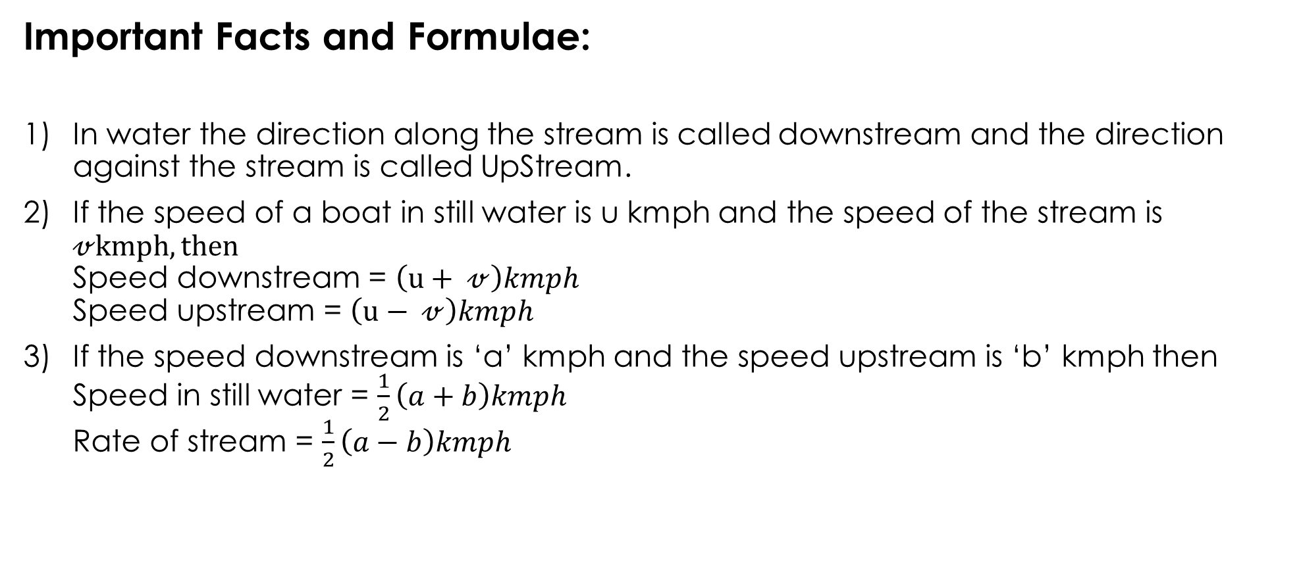
BOATS AND STREAMS
Important Facts and Formulae:
In water the direction along the stream is called downstream and the direction against the stream is called UpStream.
If the speed of a boat in still water is u kmph and the speed of the stream is $𝓋kmph, then$ Speed downstream = $\left(u+ 𝓋\right)kmph$ Speed upstream = $\left(u− 𝓋\right)kmph$
If the speed downstream is ‘a’ kmph and the speed upstream is ‘b’ kmph then Speed in still water = $\frac{1}{2}\left(a+b\right)kmph$ Rate of stream = $\frac{1}{2}\left(a−b\right)kmph$

Slide 38
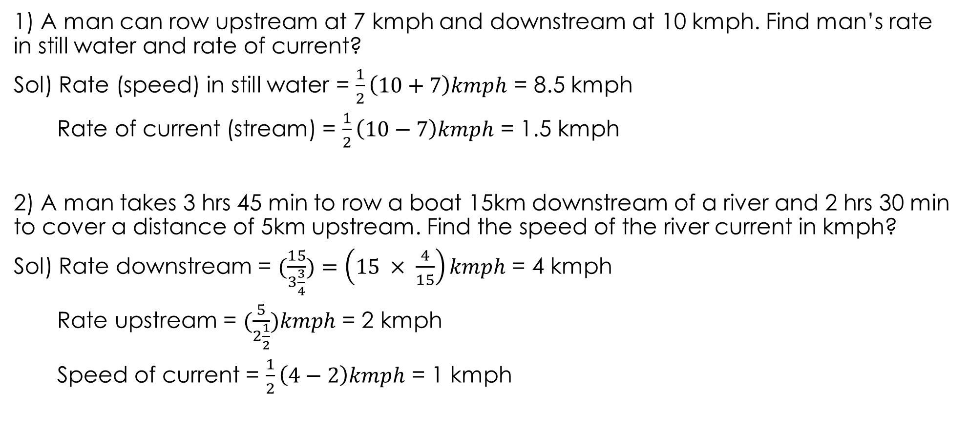
PROBLEMS
1) A man can row upstream at 7 kmph and downstream at 10 kmph. Find man’s rate in still water and rate of current?
Sol) Rate (speed) in still water = $\frac{1}{2}\left(10+7\right)kmph$ = 8.5 kmph
Rate of current (stream) = $\frac{1}{2}\left(10−7\right)kmph$ = 1.5 kmph
2) A man takes 3 hrs 45 min to row a boat 15km downstream of a river and 2 hrs 30 min to cover a distance of 5km upstream. Find the speed of the river current in kmph?
Sol) Rate downstream = $(\frac{15}{3\frac{3}{4}})=\left(15 × \frac{4}{15}\right)kmph$ = 4 kmph
Rate upstream = $(\frac{5}{2\frac{1}{2}})kmph$ = 2 kmph
Speed of current = $\frac{1}{2}\left(4−2\right)kmph$ = 1 kmph

Slide 39
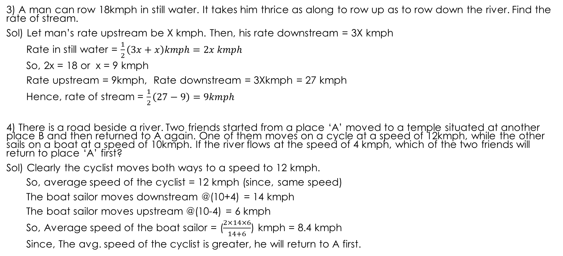
3) A man can row 18kmph in still water. It takes him thrice as along to row up as to row down the river. Find the rate of stream.
Sol) Let man’s rate upstream be X kmph. Then, his rate downstream = 3X kmph
Rate in still water = $\frac{1}{2}\left(3x+x\right)kmph=2x kmph$
So, 2x = 18 or x = 9 kmph
Rate upstream = 9kmph, Rate downstream = 3Xkmph = 27 kmph
Hence, rate of stream = $\frac{1}{2}\left(27−9\right)=9kmph$
4) There is a road beside a river. Two friends started from a place ‘A’ moved to a temple situated at another place B and then returned to A again. One of them moves on a cycle at a speed of 12kmph, while the other sails on a boat at a speed of 10kmph. If the river flows at the speed of 4 kmph, which of the two friends will return to place ‘A’ first?
Sol) Clearly the cyclist moves both ways to a speed to 12 kmph.
So, average speed of the cyclist = 12 kmph (since, same speed)
The boat sailor moves downstream @(10+4) = 14 kmph
The boat sailor moves upstream @(10-4) = 6 kmph
So, Average speed of the boat sailor = ($\frac{2×14×6}{14+6}$) kmph = 8.4 kmph
Since, The avg. speed of the cyclist is greater, he will return to A first.

Slide 40
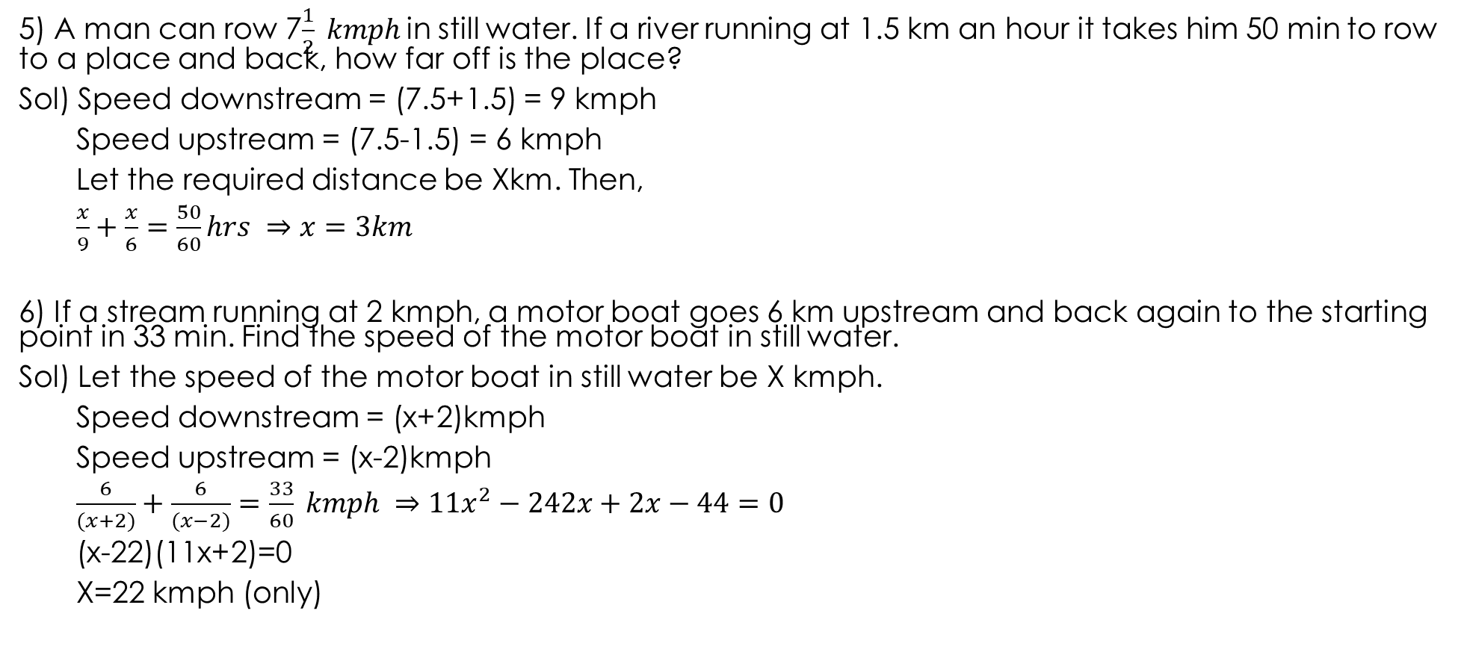
5) A man can row 7$\frac{1}{2} kmph$in still water. If a river running at 1.5 km an hour it takes him 50 min to row to a place and back, how far off is the place?
Sol) Speed downstream = (7.5+1.5) = 9 kmph
Speed upstream = (7.5-1.5) = 6 kmph
Let the required distance be Xkm. Then,
$$\frac{x}{9}+\frac{x}{6}=\frac{50}{60}hrs ⇒x=3km$$
6) If a stream running at 2 kmph, a motor boat goes 6 km upstream and back again to the starting point in 33 min. Find the speed of the motor boat in still water.
Sol) Let the speed of the motor boat in still water be X kmph.
Speed downstream = (x+2)kmph
Speed upstream = (x-2)kmph
$$\frac{6}{(x+2)}+\frac{6}{(x−2)}=\frac{33}{60} kmph ⇒11x^{2}−242x+2x−44=0$$
(x-22)(11x+2)=0
X=22 kmph (only)

Slide 41
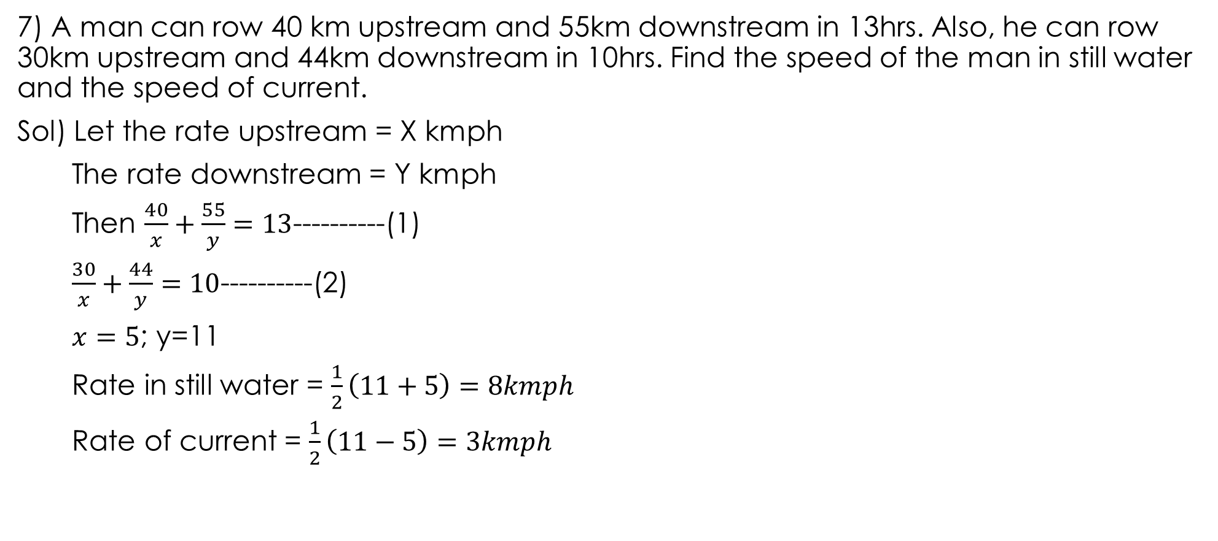
7) A man can row 40 km upstream and 55km downstream in 13hrs. Also, he can row 30km upstream and 44km downstream in 10hrs. Find the speed of the man in still water and the speed of current.
Sol) Let the rate upstream = X kmph
The rate downstream = Y kmph
Then $\frac{40}{x}+\frac{55}{y}=13$----------(1)
$\frac{30}{x}+\frac{44}{y}=10$----------(2)
$x=5$; y=11
Rate in still water = $\frac{1}{2}\left(11+5\right)=8kmph$
Rate of current = $\frac{1}{2}\left(11−5\right)=3kmph$

Slide 42
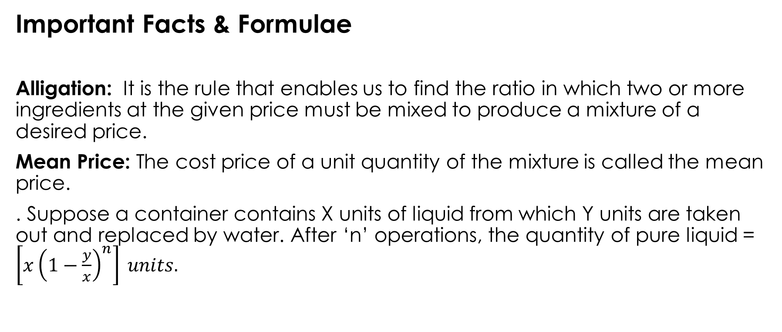
ALLIGATION OR MIXTURE
Important Facts & Formulae
Alligation: It is the rule that enables us to find the ratio in which two or more ingredients at the given price must be mixed to produce a mixture of a desired price.
Mean Price: The cost price of a unit quantity of the mixture is called the mean price.
. Suppose a container contains X units of liquid from which Y units are taken out and replaced by water. After ‘n’ operations, the quantity of pure liquid = $\left[{x\left(1−\frac{y}{x}\right)}^{n}\right] units.$

Slide 43
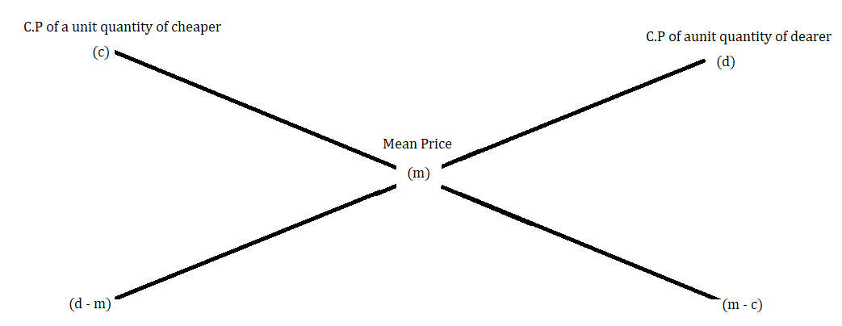
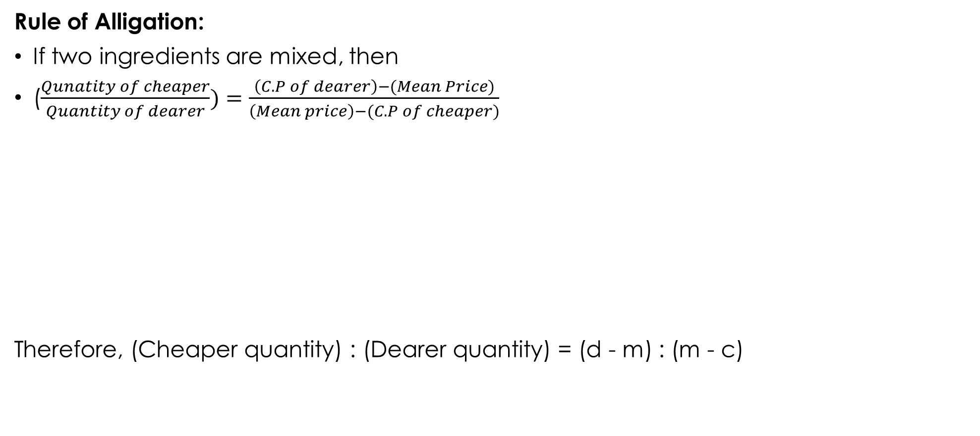
Rule of Alligation:
If two ingredients are mixed, then
($\frac{Qunatity of cheaper}{Quantity of dearer})=\frac{\left(C.P of dearer\right)−(Mean Price)}{\left(Mean price\right)−(C.P of cheaper)}$
Therefore, (Cheaper quantity) : (Dearer quantity) = (d - m) : (m - c)

Slide 44
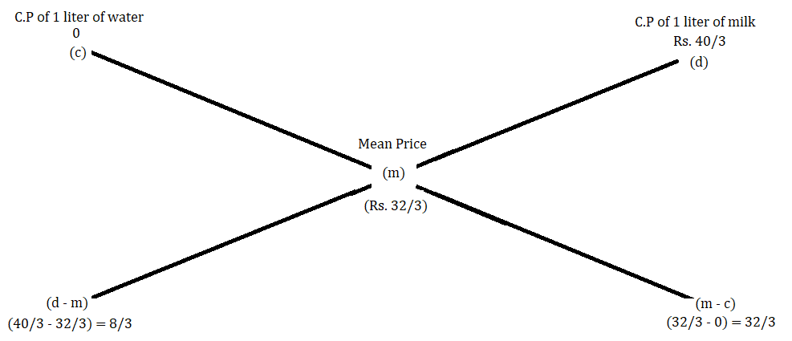
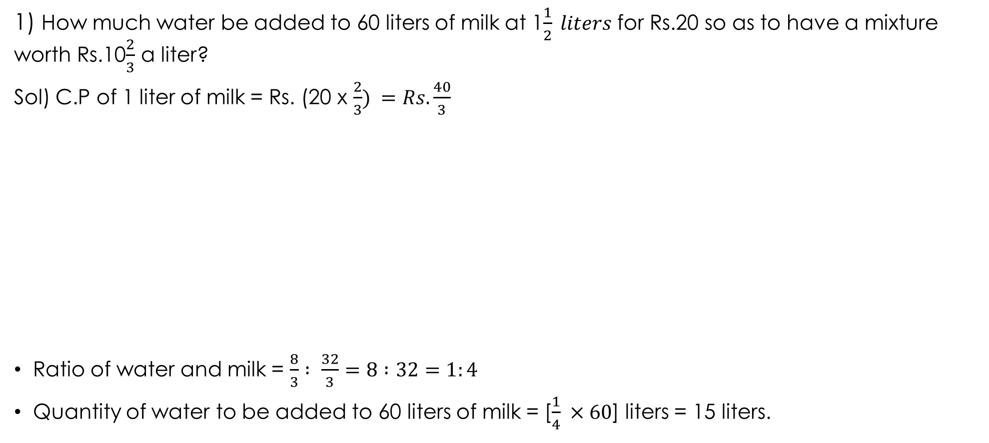
PROBLEMS
1) How much water be added to 60 liters of milk at 1$\frac{1}{2} liters$ for Rs.20 so as to have a mixture worth Rs.10$\frac{2}{3}$ a liter?
Sol) C.P of 1 liter of milk = Rs. (20 x $\frac{2}{3}) =Rs.\frac{40}{3}$
Ratio of water and milk = $\frac{8}{3} : \frac{32}{3}=8 :32=1:4$
Quantity of water to be added to 60 liters of milk = [$\frac{1}{4} ×60$] liters = 15 liters.

Slide 45
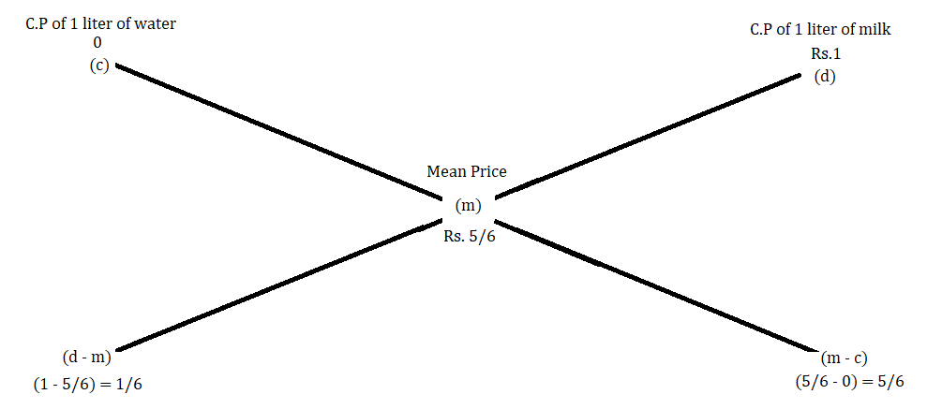
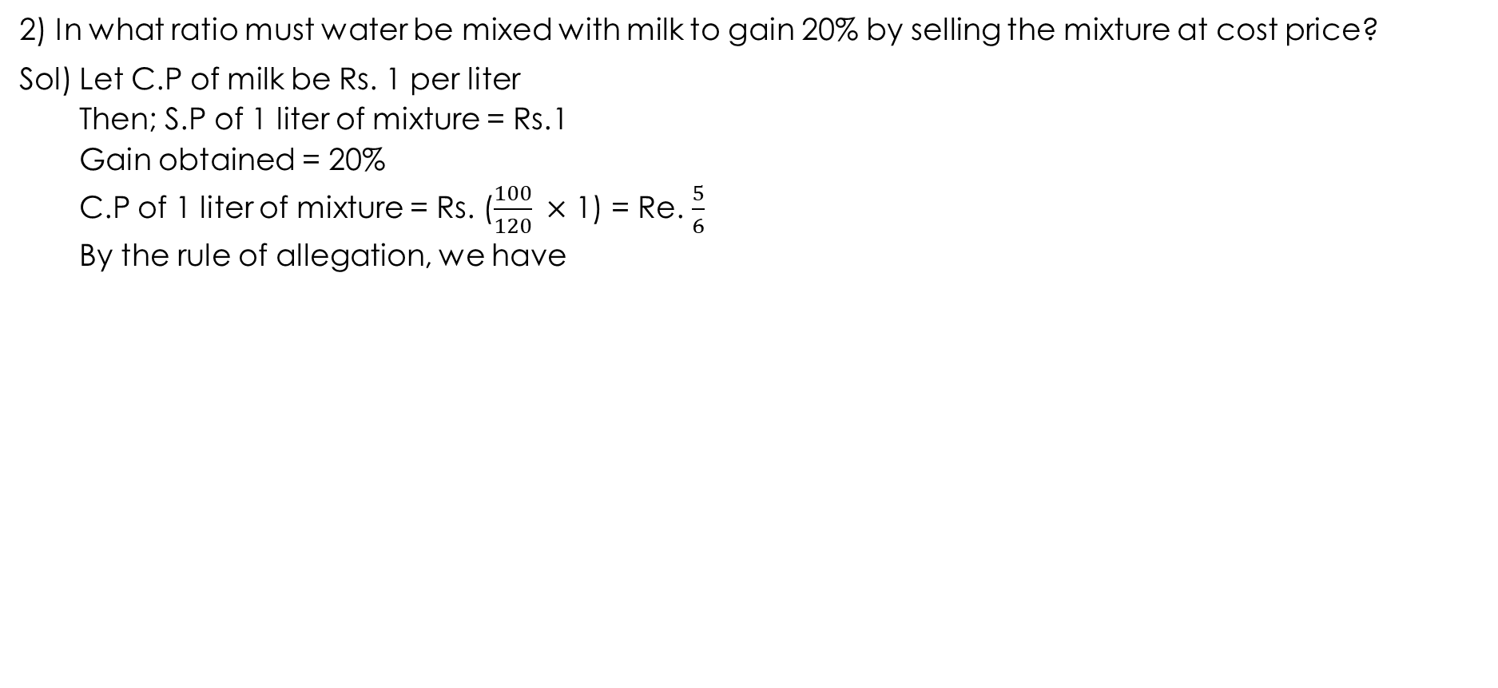
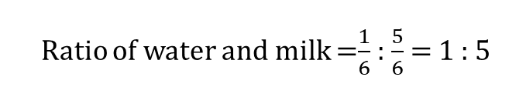
2) In what ratio must water be mixed with milk to gain 20% by selling the mixture at cost price?
Sol) Let C.P of milk be Rs. 1 per liter
Then; S.P of 1 liter of mixture = Rs.1
Gain obtained = 20%
C.P of 1 liter of mixture = Rs. ($\frac{100}{120} ×$ 1) = Re. $\frac{5}{6}$
By the rule of allegation, we have
Ratio of water and milk =$\frac{1}{6}$ : $\frac{5}{6}$ = 1 : 5

Slide 46
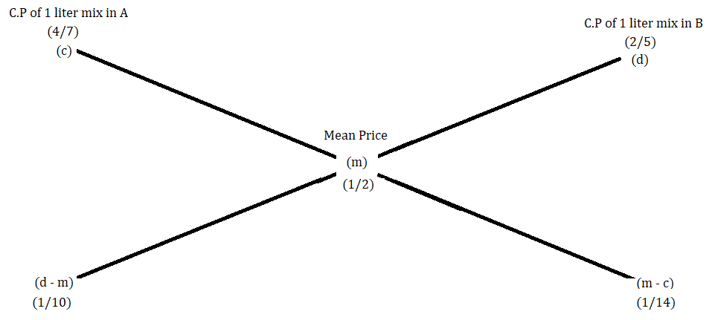
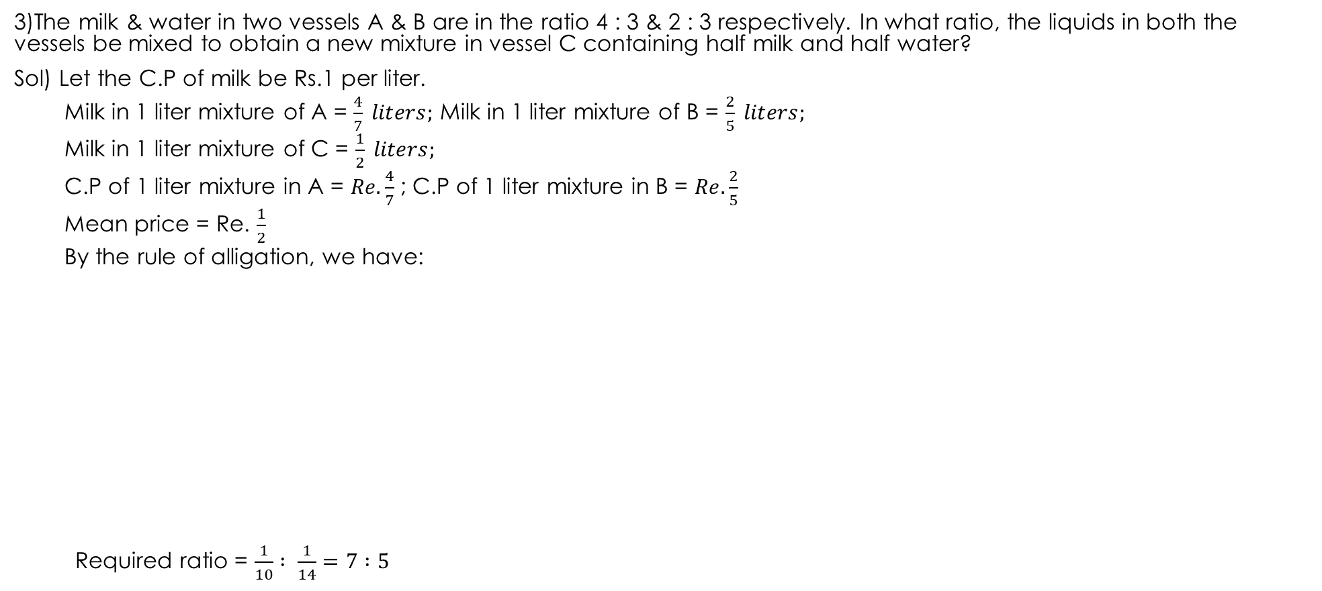
3)The milk & water in two vessels A & B are in the ratio 4 : 3 & 2 : 3 respectively. In what ratio, the liquids in both the vessels be mixed to obtain a new mixture in vessel C containing half milk and half water?
Sol) Let the C.P of milk be Rs.1 per liter.
Milk in 1 liter mixture of A = $\frac{4}{7} liters;$ Milk in 1 liter mixture of B = $\frac{2}{5} liters;$
Milk in 1 liter mixture of C = $\frac{1}{2} liters;$
C.P of 1 liter mixture in A = $Re.\frac{4}{7}$ ; C.P of 1 liter mixture in B = $Re.\frac{2}{5}$
Mean price = Re. $\frac{1}{2}$
By the rule of alligation, we have:
Required ratio = $\frac{1}{10} : \frac{1}{14}=7 :5$

Slide 47
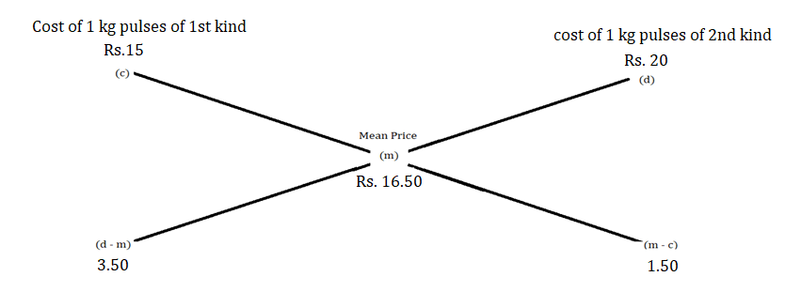
4) In what ratio must a grocer mix two varieties of pulse costing Rs.15 and Rs.20 per kg respectively so as to get a mixture worth Rs. 16.50 per kg?
Sol)
Required ratio = 3.50 : 1.50 = 35 : 15 = 7 : 3

Slide 48
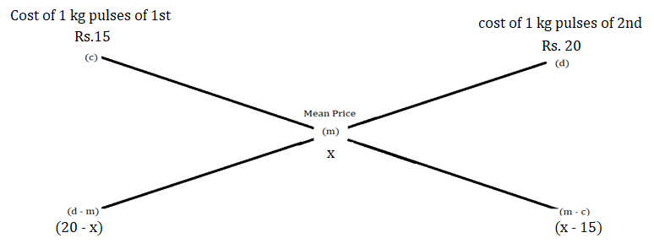
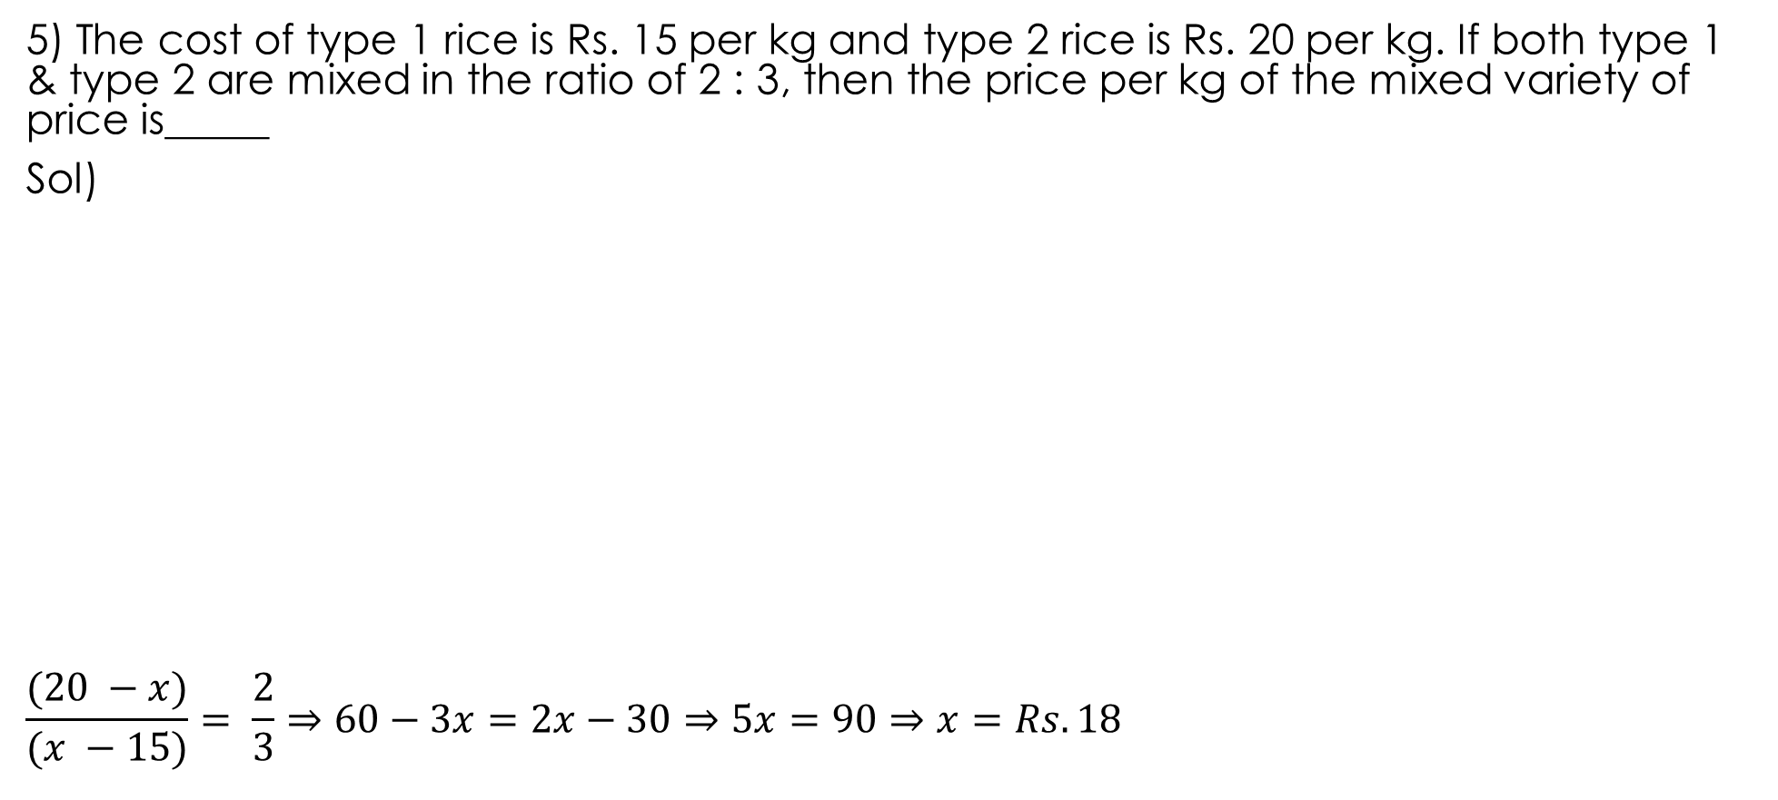
5) The cost of type 1 rice is Rs. 15 per kg and type 2 rice is Rs. 20 per kg. If both type 1 & type 2 are mixed in the ratio of 2 : 3, then the price per kg of the mixed variety of price is_____
Sol)
$$\frac{(20 −x)}{(x −15)}= \frac{2}{3}⇒60−3x=2x−30⇒5x=90⇒x=Rs.18$$

Slide 49

6) 8 liters are drawn from ‘a’ cask full of wine and is then filled with water. This operation is performed 3 more times. The ratio of quantity of wine left in cask to that of the water is 16 : 81. How much wine did the cask hold originally?
Sol) Let the quantity of the wine in the cask originally be X liters.
Then, quantity of wine left in cask after 4 operations = [${x(1−\frac{8}{x})}^{4}$] liters.
$$\frac{{x(1−\frac{8}{x})}^{4}}{x}=\frac{16}{81}⇒{(1−\frac{8}{x})}^{4}={(\frac{2}{3})}^{4}⇒\frac{x−8}{x}=\frac{2}{3}$$
⇒3x – 24 = 2x ⇒ x = 24 liters.

Slide 50

SIMPLE INTEREST & COMPOND INTEREST
Important Facts & Formulae
Principal: The money borrowed or lent out for a certain period is called the principal or the sum.
Interest: Extra money paid for using others money is called interest.
Simple Interest (S.I): If the interest on a sum borrowed for a certain period is reckoned uniformly, then it is called S.I.
Let Principal = P, Rate = R% per annum and Time = T years,
Then,
S.I = ($\frac{\text{PxTxR}}{100})$, P = ($\frac{100xS.I}{TxR})$ etc.,

Slide 51

PROBLEMS
Find the S.I. on Rs.68,000 at 16$\frac{2}{3}$% p.a. for 9 months.
Sol) Here, given P = 68,000, R = $\frac{50}{3}$% p.a. and T =9 months = $\frac{9}{12}$ yrs = $\frac{3}{4}$ yrs.
=> S.I = $\frac{68,0000x50x3}{100x3x4}=Rs. 8500$.
2) Find the S.I on Rs.3000 at 6$\frac{1}{4}$% p.a. for the period from 4th Feb, 2005 to 18th April, 2005.
Sol) Time = 24+31+18 = 73 days = $\frac{73}{365}$yrs = $\frac{1}{5 }$ yrs
=> P = Rs.3000 and R = 6$\frac{1}{4}$% p.a = $\frac{25}{4}$% p.a
S.I. = Rs.37.50.
Note: The day on which money is deposited is not counted while the day on which the money is withdrawn is counted.

Slide 52

3. A sum at S.I at 13$\frac{1}{2}$% p.a amounts to Rs.2502.50 after 4 years. Find the sum.
Sol: Let the sum be Rs.x then,
S.I =(X×$\frac{27}{2}$x4x $\frac{1}{100})$ =Rs. $\frac{27x}{50}$
Amount =(x+ $\frac{27x}{50}$) => x+ $\frac{27x}{50}=$2502.50
x= Sum = Rs.1625
4.A sum of 800/- amounts to Rs.920 in 3years at S.I. If the interest rate is increased by 3%, it would amount to how much?
Sol: Sum=800, Amount=920 =>S.I=120/- , T=3 years (amount=sum+S.I)
=> R= ($\frac{100X120}{800X3}$)% =5%
=> New rate=(5+3)% =8%
=> New simple interest =($\frac{800X3X8}{100}$) = Rs.192
New amount =(800+192) =992/-

Slide 53

5.A man borrowed some money @6% p.a. for the first two years, @ of 9% p.a for the next three years, and @ 14% p.a. for the period beyond 5 years. If he pays a total interest of 11400/- at the end of the nine years , how much money did he borrow?
Sol : Let the sum borrowed be x then,
($\frac{xX2X6}{100}$)+($\frac{xX3X9}{100}$) )+($\frac{xX4X14}{100}$)=11400
=>X= 12000/- = sum borrowed
6.At what rate percent per annum will a sum of money double in 16 years?
Sol : Let principal = P then, S.I = P and T=16 years
R=($\frac{100Xp}{pX16}$)% =6$\frac{1}{4}$% p.a
7.A certain sum of money amounts to Rs.1008 in 2 years and to Rs. 1164 in 3 $\frac{1}{2}$years . Find the sum and the ROI.
Sol : S.I. for 1$\frac{1}{2}$years = Rs.(1164-1008) = Rs.156
S.I for 2 years = Rs.(156X $\frac{2}{3}$X2) = Rs.208 =S.I
Principal= Rs.(1008-208) = Rs.800 =P
Rate = 13% (t = 2 yrs, S.I. = 208)

Slide 54

8. The S.I on a sum of money is $\frac{4}{9}$ of the principal. Find the rate percent and time, if both are numerically equal?
Sol : Let the sum = principal = Rs.X , then S.I = $\frac{4x}{9}$
Let the rate= R% and time= R years
$\frac{xXRXR}{100}$= $\frac{4x}{9}$ =>$R^{2}$= $\frac{400}{9}$ => R=6 $\frac{2}{3}$
Rate= 6 $\frac{2}{3}$% , Time= 6 $\frac{2}{3}$years= 6years 8 months
9.A sum of Rs.1550 is lent out into two parts, one at 8% and another one at 6%. If the total annual income is Rs.106, Find the money lent at each rate.
Sol : Let the sum lent at 8% be Rs.X and that 6% be (1550-X)
($\frac{xX8X1}{100}$)+($\frac{(1550−x)X6X1}{100}$) = 106
X=650
Money lent out at 8%=650/- and at 6%=(1550-650) =900/-
10.The S.I on a certain sum of money for 2 $\frac{1}{2}$ years at 12% per annum is Rs.40 less than the S.I on the same sum for 3 $\frac{1}{2}$ years at 10% p.a. Find the sum?
Sol : Let the sum be Rs.X , then ($\frac{xX10X7/2}{100}$)-($\frac{xX5/2X12}{100})$ = 40
X=800/-

Slide 55

11.Reena took a loan of Rs.1200 with S.I. for as many years as the ROI. If she paid RS.432 as Interest at the end of the loan period , what was the ROI?
Sol: Let rate=R% and time= R years. Then
$\frac{1200XRXR}{100}$ = 432 => R=6% p.a.
12.The S.I. at X% for X years will be Rs.X on a sum of ________
Sol: The sum=($\frac{100XS.I.}{RXT})$=Rs.($\frac{100}{X}$)
13.A sum invested at 5% S.I. p.a. grows to Rs.504 in 4years.The same amount at 10% S.I. p.a. in 2$\frac{1}{2}$ years will grow to ______________
Sol: Let the sum be Rs.x then S.I.=(504-x).
=>$(\frac{xX5X4}{100}$)=(504-x)
=> x=420.
now p=420, R=10% p.a. T=$\frac{5}{2 }years$
=> S.I.=($\frac{420X10X5}{100X2}$)=Rs.105
Amount = 420+105 = 525.

Slide 56

14. What will be the ratio of S.I. earned by certain amount at the same rate of interest for 6
years and that for 9 years ?
Sol: Let the principal=P and rate of interest be R%
=> ratio= $\frac{(PXRX6)/100}{(PX9XR)/100}$ = $\frac{2}{3}$
15. A lends Rs.2500 to B and a certain sum to C at the same time at 7% p.a. S.I. If after 4 years, A altogether receives Rs.1120 as interest from B and C , then the sum lent to C is____________
Sol: Let the sum lent to c be Rs.x, then
($\frac{2500X7X4}{100}$)+($\frac{xX7X4}{100}$)=1120 => x=Rs.1500
16.A sum of money lent out at simple interest amounts to Rs.720 after 2years and to Rs.1020 after 2 years and to Rs.1020 after a further of 5years then the sum is____________
Sol: Given S.I. for 5years =1020-720=Rs. 300
S.I. for 1 year =Rs.$\frac{300}{5}$
=> S.I. for 2 years =Rs.($\frac{300}{5}$x2)=Rs.120
=> principal = Rs.(720-120)=Rs.600.

Slide 57

17. A sum of Rs.725 is lent in the beginning of a year at a certain rate of interest. After 8 months a sum of Rs.362.50 more is lent but at the rate twice the former. At the end of the year Rs.33.50 is earned as interest from both the loans. What was the original rate of interest?
Sol: Let the original rate be X% then New rete=2X%
After 8 months = 12-8=4 => T=$\frac{4}{12}$=$\frac{1}{3}$years
=> ($\frac{725XxX1}{100}$)+($\frac{362.50X2xX1}{100X3}$)=33.50
=> (2175+725)$x$=33.50X300
=>$\left(x\right)$=3.46%
original rate =3.46%
18. A sum of Rs.12500 amounts to RS.15500 in 4 years at the rate of S.I. What is the rate of interest?
Sol: Given S.I. =( 12500-15500)=Rs. 3000
and P=Rs.12500, T=4 years
=> R= ($\frac{100XS.I.}{PXT}$)=6%
Rate of interest = 6%

Slide 58

COMPOUND INTEREST
COMPOUND INTEREST:
Sometimes it so happens that the borrower and the lender agree to fix up a certain unit of time ,say yearly or half yearly or quarterly to settle the previous account.
In such cases, the amount after first unit of time becomes the principal for the second unit, the amount after second unit becomes the principal for the third unit and so on…
After a specified period ,the difference between the Amount and the money borrowed is called the C.I. for that period.
Important facts and formulae:
Let the principal=P, Rate=R% p.a. & Time = n years
1.When interest is compounded annually:
Amount = P${(1+\frac{R}{100})}^{n}$
2.When interest is compounded half yearly:
Amount = P${(1+\frac{(\frac{R}{2})}{100})}^{2n}$

Slide 59

3.When interest is compounded quarterly :
Amount = P${(1+\frac{(\frac{R}{4})}{100})}^{4n}$
4.When interest is compounded annually but time is in fraction say, 3$\frac{2}{5}$ years:
Amount = P${(1+\frac{R}{100})}^{3}∗\left(1+\frac{\frac{2}{5}R}{100}\right)$
5.When rates are different for different years ,say $R_{1}$%, $R_{2}$%, $R_{3}$% for 1st ,2nd and
3rd year respectively then
Amount = P(1+$\frac{R_{1}}{100}$)(1+$\frac{R_{2}}{100}$)(1+$\frac{R_{3}}{100}$)
6.Present worth of Rs.x due n years hence is given by :
Present worth = $\frac{x}{{(1+\frac{R}{100})}^{n}}$

Slide 60

1.Find the C.I. on Rs.7500 at 4% p.a. for 2 years, compounded annually.
Sol: Amount = 7500x(${(1+\frac{4}{100})}^{2}$ =Rs.8112.
=> C.I.= 8112-7500 = Rs.612
2.Find C.I. on Rs.8000 at 15% p.a. for 2 years 4months ,compounded annually.
Sol: Given T= 2 years 4 months= 2$\frac{1}{3}$ years
=> Amount = 800${(1+\frac{15}{100})}^{2}$x(1+$\frac{\frac{15}{3}}{100}$)=Rs.11109
=> C.I.=11109-8000=Rs.3109.
3.Find the C.I. on 10000 in 2 years at 4% p.a. ,the interest being compounded half-yearly.
Sol: Here Amount = P${(1+\frac{(\frac{R}{2})}{100})}^{2n}$
Given P=10000, T= 2years =4 half years, R=4%, n=2 yrs
Amount=10000${(1+\frac{\frac{4}{2}}{100})}^{4}$ =Rs.10824.32
C.I.= Amount-Principal=10824.32-10000=Rs 824.32.

Slide 61

4.Find the C.I. on 16k at 20% p.a. for 9 months compounded quarterly.
Sol: Given P= 16000 ,R= 20%, T= 9months= 3 quarters = 9/12 yrs. = ¾ yrs
Amount=P${(1+\frac{(\frac{R}{4})}{100})}^{4n}$=16000${(1+\frac{5}{100})}^{3}$=18522
C.I.= Amount-Principal=18522-16000=2522.
5.If the S.I. on a sum of money at 5% p.a. for 3 years is Rs.1200, find the C.I. on the same sum for the same period at the same rate.
Sol: Given rate =5% p.a., Time=3 years, S.I.=Rs. 1200 and
Principal= Rs.($\frac{100X1200}{3X5}$)=Rs.8000. = P
Amount=8000${(1+\frac{5}{100})}^{3}$=Rs.9261
C.I.=Rs.(9261-8000)=Rs.1261.
6.In what time will Rs.1000 become Rs.1331at 10% p.a. compounded annually.
Sol: Given principal=1000, Amount=Rs.1331, rate=10%p.a.
let the time be n years
=> 1000${\left(1+\frac{ 10}{100}\right)}^{n}$=1331 => n=3 years.

Slide 62

7.If Rs.500 amounts to Rs.583.20 in two years compounded annually, find the rate of interest p.a.
Sol: Given P=Rs.500 , Amount= Rs.583.20, Time=2years
Let the rate be R% p.a. then,
500${(1+\frac{R}{100})}^{2}$ = Rs.583.20
=>${(+\frac{R}{1100})}^{2}$ = $\frac{5832}{5000}$ = $\frac{11664}{10000}$
=>${(1+\frac{R}{1100})}^{2}$ =${ (\frac{108}{100})}^{2}$
=> 1+$\frac{R}{100}$ = $\frac{108}{100}$ => R=8% p.a.
8. If the C.I. on a certain sum at 16$\frac{2}{3}$ % for 3 years is Rs.1270, Find the S.I. on the same sum at the same rate for the same period .
Sol: Let the sum be Rs. X. Then,
C.I.=(x${(1+\frac{50}{300})}^{3}$-x)=$\frac{127x}{216}$ = Rs.1270
=> x = $\frac{1270X216}{127}$ = Rs.2160 => sum=Rs.2160
S.I.= Rs.(2160x $\frac{50}{3}$x3x$\frac{1}{100}$) = Rs.1080.

Slide 63

9.The difference between the C.I. and S.I. on a certain sum at 10% p.a. for 2 years is Rs.631. Find the sum.
Sol: Let the sum be x then
C.I.= x${(1+\frac{10}{100})}^{2}$-x =$\frac{21x}{100}$ , S.I.=($\frac{xX10X2}{100}$)=$\frac{x}{5}$
=> (C.I.)-(S.I.)=$\frac{21x}{100}$ - $\frac{x}{5}$ = $\frac{x}{100}$
=> x/100= Rs. 631 => The sum is = X = Rs.63100.
10.The difference between the C.I. and the S.I. accrued on an amount of Rs.18000 in 2 years was Rs.405. What was the rate of interest p.c.p.a.?
Sol: Let the rate be R% p.a. then
[18000${(1+\frac{R}{100})}^{2}$-18000]-($\frac{18000XRX2}{100}$)=405
=> 18000[$\frac{{(100+R)}^{2}}{10000}$ -1-$\frac{2R}{100}$]=405
=>$\frac{9}{5}R^{2}$=405 =>$R^{2}$=225 => R= 15%.

Slide 64

11.Dvide Rs.1301 between A and B , so that the amount of A after 7 years is equal to the amount of B after 9 years, the interest being compounded at 4% p.a.
Sol: Let the two parts be Rs.x and Rs.(1301-x)
=> x${(1+\frac{4}{100})}^{7}$=(1301-x)${(1+\frac{4}{100})}^{9}$ => x=676
and (1301-x)=625.
12.A sum of money amounts to Rs.6690 after 3 years and to Rs.10035 after 6 years on C.I. Find the sum.
Sol: Let the sum be Rs. P.
=> P${(1+\frac{R}{100})}^{3}$=6690------ (1 ) and P${(1+\frac{R}{100})}^{6}$=10035------- (2)
=>$\frac{(2)}{(1)}$ =>${ (1+\frac{R}{100})}^{3}$= $\frac{3}{2}$ , sub. in ------------(1)
=> P = Rs.4460
13.A sum of money doubles itself at C.I. in 15 years .In how many years will it become eight times.
Sol: Given n=15 years , then
=> P${(1+\frac{R}{100})}^{15}$ = 2P =>${(1+\frac{R}{100})}^{15}$=2--------------(1)
Let P${(1+\frac{R}{100})}^{n}$=8P =>${(1+\frac{R}{100})}^{n}$=8=$2^{3}$----------(2)
=> from (1) and (2) => n = 45 years

Slide 65

14.What annual payment will discharge a debt of Rs.7650 due in 3 years at 16$\frac{2}{3}$%p.a. C.I.?
Sol: Let the each instalment be Rs.x then ,
(P.W. of Rs.x due 1 year hence )+(P.W. of Rs.x due 2 year hence)+(P.W.ofRs.x due 3 years hence)=Rs. 7620
=>$\frac{x}{(1+\frac{50}{100})}$+$\frac{x}{(1+{\frac{50}{300})}^{2}}$+$\frac{x}{(1+{\frac{50}{100})}^{3}}$=7620
=>$\frac{6x}{7}$+$\frac{36x}{49}+\frac{216x}{343}$=7620
=> x = Amount of each instalment = Rs.3430.
15.A man saves Rs.200 at the end of each year and lends the money at 5% C.I. How much will it become at the end of three years?
Sol: Given P=200,R=5%, n= 1,2, 3 years
Amount = Rs.[ 200(1+$\frac{5}{100}$)+200${(1+\frac{5}{100})}^{2}$+200${(1+\frac{5}{100})}^{3}$]
Amount=Rs.662.02.
16.The C.I. on Rs.30k at 7% p.a. is 4347. The period (in years) is------------
Sol: Amount = sum + C.I.= 30k+ 4347=34347
Let the time be n years then
30k${(1+\frac{7}{100})}^{n}$=34347 =>${(\frac{107}{100})}^{n}$=$\frac{34347}{30000}$=$({\frac{107}{100})}^{2}$
=> n=2 years.

Slide 66

17.The principal that amounts to Rs. 4913 in 3years at 6$\frac{1}{4}$% p.a. C.I. compounded annually is___
Sol: Given Amount=Rs.4913, R=$\frac{25}{4}$% and n=3 years
=> Amount= P${(1+\frac{R}{100})}^{n}$
=> P=$\frac{Amount}{(1+{\frac{25}{400})}^{3}}$ = $\frac{4913}{{(\frac{17}{16})}^{3}}$ = Rs. 4096.
18.A person lent out a certain sum on S.I. and the same sum on C.I. at a certain ROI p.a. He noticed that the ratio between the difference of C.I. and S.I. of 3 years and that of 2 years is 25:8 .The rate of interest p.a. is________
Sol: Let the principal (sum) be Rs.P and rate of interest be R% per annum
=> The difference of C.I. and S.I. for 2 years is
= [P${(1+\frac{R}{100})}^{2}−P]−(\frac{PX2XR}{100})=\frac{{PR}^{2}}{{10}^{4}}$-------------------(1)
And difference of C.I. and S.I. for 3 years is
= P${(1+\frac{R}{100})}^{3}−P]−(\frac{PX3XR}{100})=\frac{{PR}^{2}}{{10}^{4}}(\frac{300+R}{100}$)-------------(2)
=>$\frac{(2)}{(1)}$ = $\frac{25}{8}$ =>$\frac{300+R}{100}$= $\frac{25}{8}$ => R= $\frac{100}{8}$=12$\frac{1}{2}$%.

Slide 67

19.The least number of complete years in which a sum of money put out at 20% C.I. will be more than double is______
Sol: Let the principal =P then given
P${(1+\frac{20}{100})}^{n}$> 2P =>${(\frac{6}{5})}^{n}$> 2
=> for n = 4 the inequation holds => n= years.
20. A man borrows Rs. 2550 to be paid back with C.I. at the rate of 4% p.a. by the end of 2years in two equal yearly instalments . How much will each instalment be?
Sol: Let the value of each instalment be Rs. X then
( present worth of Rs. X due 1 year hence)+(P.W. of Rs.X due 2 year hence)=2550
=>$\frac{x}{(1+\frac{4}{100})}$+$\frac{x}{{(1+\frac{4}{100})}^{2}}$ =2550 => x= value of each instalment
x=Rs. 1352.

Slide 68
Thank You

